Slide 1

E4S: The Extreme-scale Scientific Software Stack Release 25.06
Release 25.06 notes
June 6, 2025
High Performance Software Foundation
E4S Team

Slide 2
E4S 25.06: What’s New?
E4S includes 130+ HPC packages on ARM, x86_64, and ppc64le platforms.
E4S improves support for a cross-platform AI/ML software stack including packages like NVIDIA BioNeMoTM, NVIDIA NeMoTM, Vllm, HuggingFace CLI, TensorFlow, PyTorch, Google.generativeai (Gemini API), OpenAI (API), TorchBraid, Pandas, Scikit-Learn, JAX, OpenCV, and LBANN with support for GPUs.
Support for new architecture: NVIDIA Blackwell (sm_120).
Updates to language and runtime: Chapel with support for AMD and NVIDIA GPUs
New tools: libCEED
Applications include: CP2K, DealII, FFTX, GROMACS, LAMMPS, Nek500, Nekbone, NWChem, OpenFOAM, WarpX, WRF, Quantum Espresso, and Xyce
E4S DocPortal updated with AI/ML tools.
CUDA upgraded to 12.8 (aarch64, x86_64), ROCm upgraded to 6.3.3, oneAPI upgraded to 2025.1.
Adaptive Computing’s Heidi AI/HPC Cloud on demand data center (ODDC) web-based platform for multi-user, multi-node ParaTools Pro for E4STM images on AWS, Azure, Google Cloud, and OCI Marketplace with NVIDIA GPUs with VNC based remote desktop and Torque (qsub) and SLURM (sbatch) for multi-node execution:
https://adaptivecomputing.com/ and https://paratoolspro.com

Slide 3












E4S: Extreme-scale Scientific Software Stack
About E4S
https://e4s.io
E4S is an ecosystem for science and a community effort to provide open-source software packages for developing, deploying and running scientific applications on HPC platforms.
E4S has built a comprehensive, coherent software stack that enables application developers to productively develop highly parallel applications that effectively target diverse exascale architectures.
E4S provides a curated, Spack based software distribution of 130+ HPC (OpenFOAM, Gromacs, Nek5000, LAMMPS), EDA (e.g., Xyce), and AI/ML packages (e.g., NVIDIA NeMoTM, NVIDIA BioNeMoTM, Vllm, HuggingFace CLI, TensorFlow, PyTorch, OpenCV, TorchBraid, Scikit-Learn, Pandas, JAX, LBANN with support for GPUs).
Base images and full featured containers (with GPU support) and DOE LLVM containers.
Commercial support for E4S through ParaTools, Inc. for installation, maintaining an issue tracker, and ECP AD engagement.
E4S for commercial clouds: Adaptive Computing’s ODDC with ParaTools Pro for E4STM image for AWS, GCP, Azure, OCI.
With E4S Spack binary build caches, E4S supports both bare-metal and containerized deployment for GPU based platforms.
x86_64, ppc64le (IBM Power 10), aarch64 (ARM64) with support for CPUs and GPUs from NVIDIA, AMD, and Intel
Container images on DockerHub and E4S website of pre-built binaries of ECP ST products.
e4s-chain-spack.sh to chain two Spack instances allows us to install new packages in home directory and use other tools.
e4s-cl container launch tool allows binary distribution of applications by swapping MPI in the containerized app w/ system MPI.
e4s-alc is an à la carte tool to customize container images by adding system and Spack packages to an existing image.
E4S 25.06 released on June 6, 2025: https://e4s.io/talks/E4S_25.06.pdf
Notes:
LOCAL LAB POC: Michael Heroux (maherou@sandia.gov)
TALKING POINTS:
PESO is a five-year post-ECP software-ecosystem stewardship and advancement project. In partnership with the Consortium for the Advancement of Scientific Software (CASS), PESO will establish and steward a sustainable scientific software ecosystem comprising libraries and tools that deliver the latest high-performance algorithms and capabilities for DOE mission-critical applications.
PESO will enable applications to realize 100X improvement in both high-end capabilities and energy efficiency by leveraging accelerator devices
PESO will emphasize software product quality, the continued fostering of software product communities, and the delivery of products, working with CASS
METADATA:
Name of the associated awarded project:
PI name(s): Michael Heroux (Sandia), Lois Curfman McInnes (Argonne)
Name of the program manager: William Spotz, Software Stewardship and Advancement
CITATIONS:
The notes section should also include full citations (including the DOI) to any important and associated publications, datasets or code developed as part this work.
N/A
AWARDS:
N/A
REPRODUCIBILITY:
N/A.
BACKGROUND AND CONTEXT INFORMATION:
N/A

Slide 4
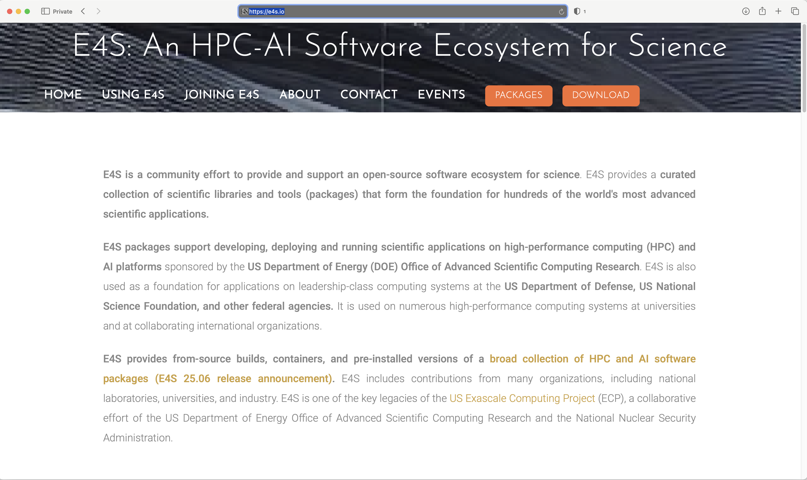
E4S Download from https://e4s.io

Slide 5
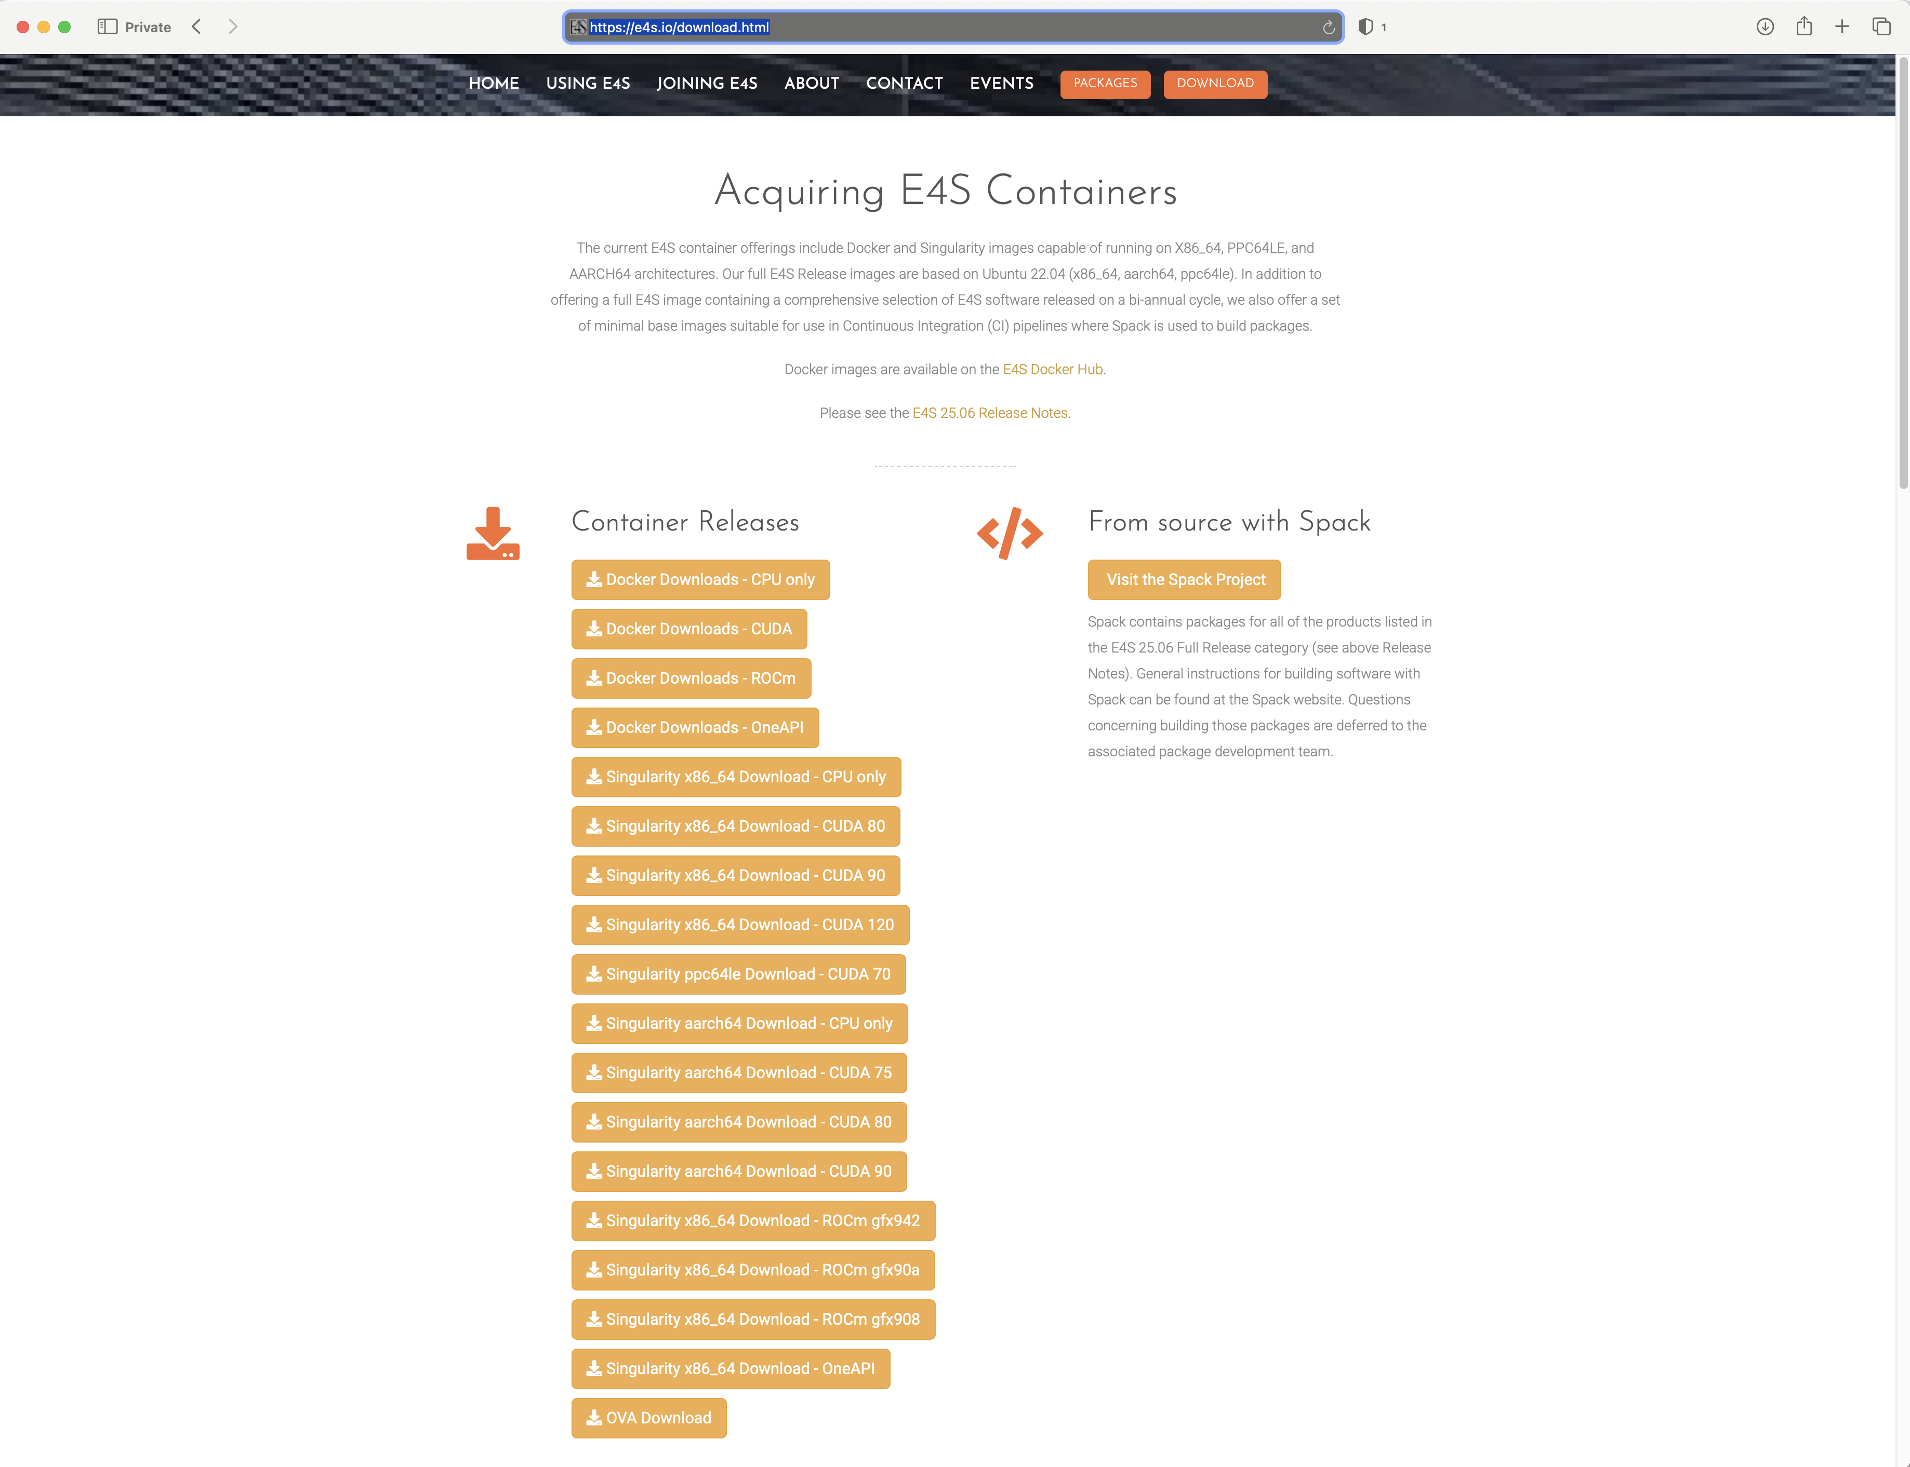
E4S Container Download from https://e4s.io
Separate full featured Singularity images for 3 GPU architectures
GPU full featured images for
x86_64 (Intel, AMD, NVIDIA)
ppc64le (NVIDIA)
aarch64 (NVIDIA)
Full featured images available on Dockerhub
130+ products on 3 architectures

Slide 6
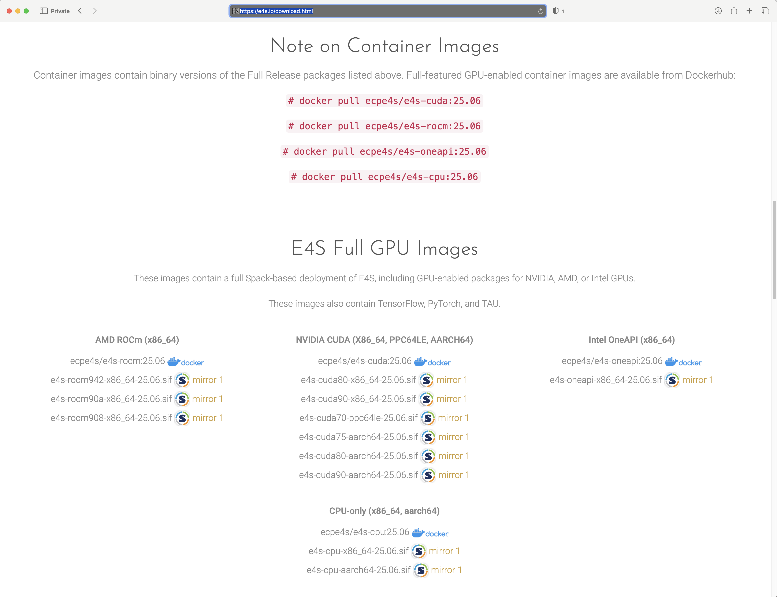
Download E4S 25.06 GPU Container Images: AMD, Intel, and NVIDIA
https://e4s.io
Notes:
quick run through - what ECP ST is working on

Slide 7
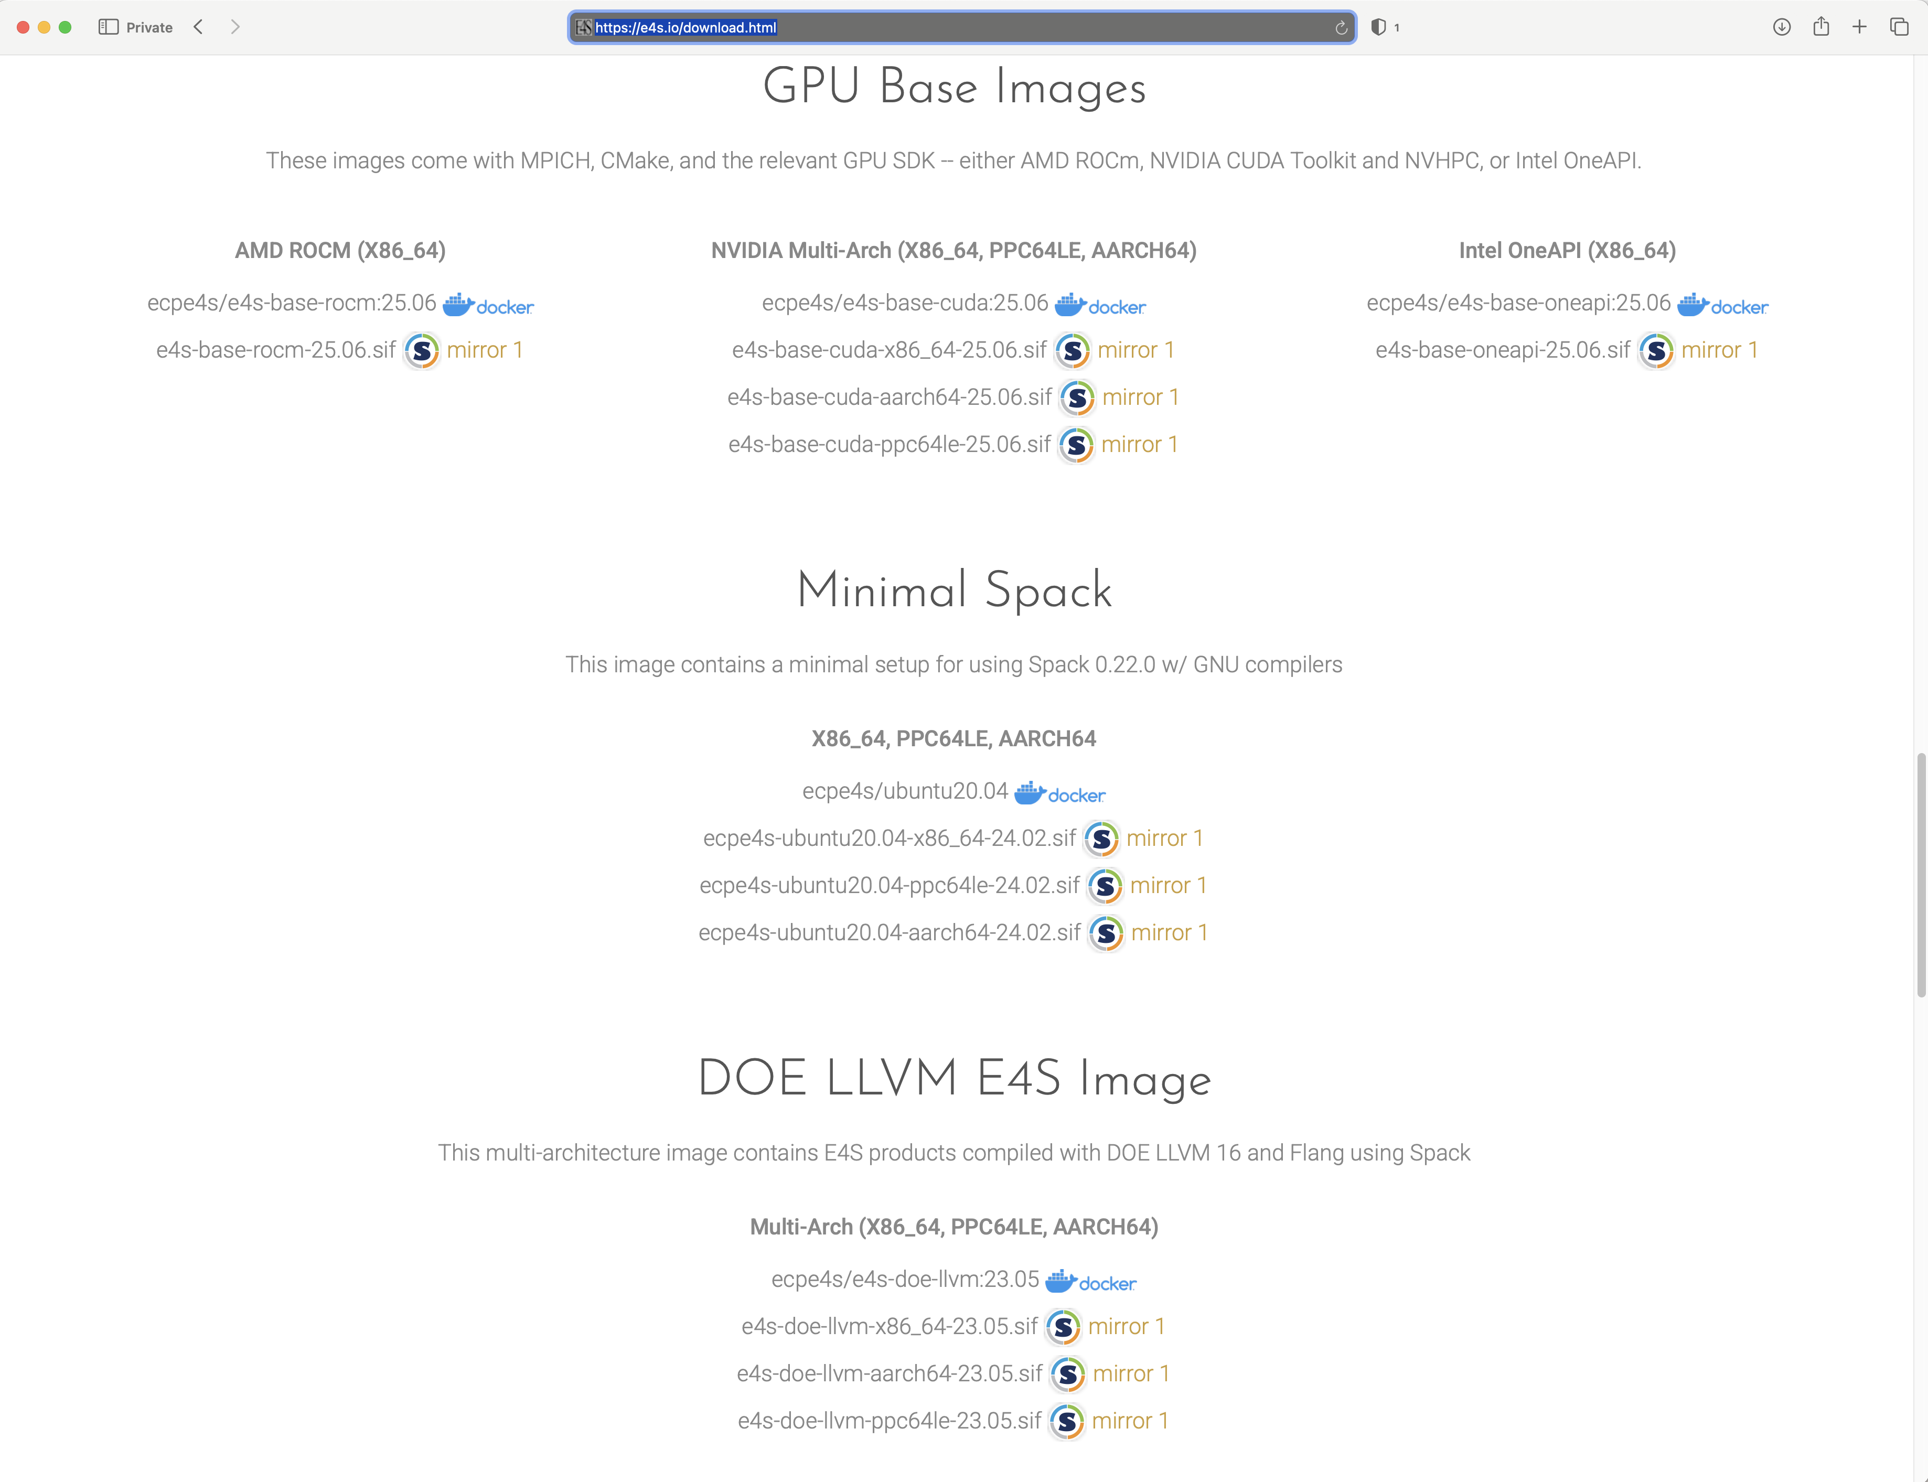
E4S base container images allow users to customize their containers
Intel oneAPI
AMD ROCm
NVIDIA CUDA
https://e4s.io
Notes:
quick run through - what ECP ST is working on

Slide 8
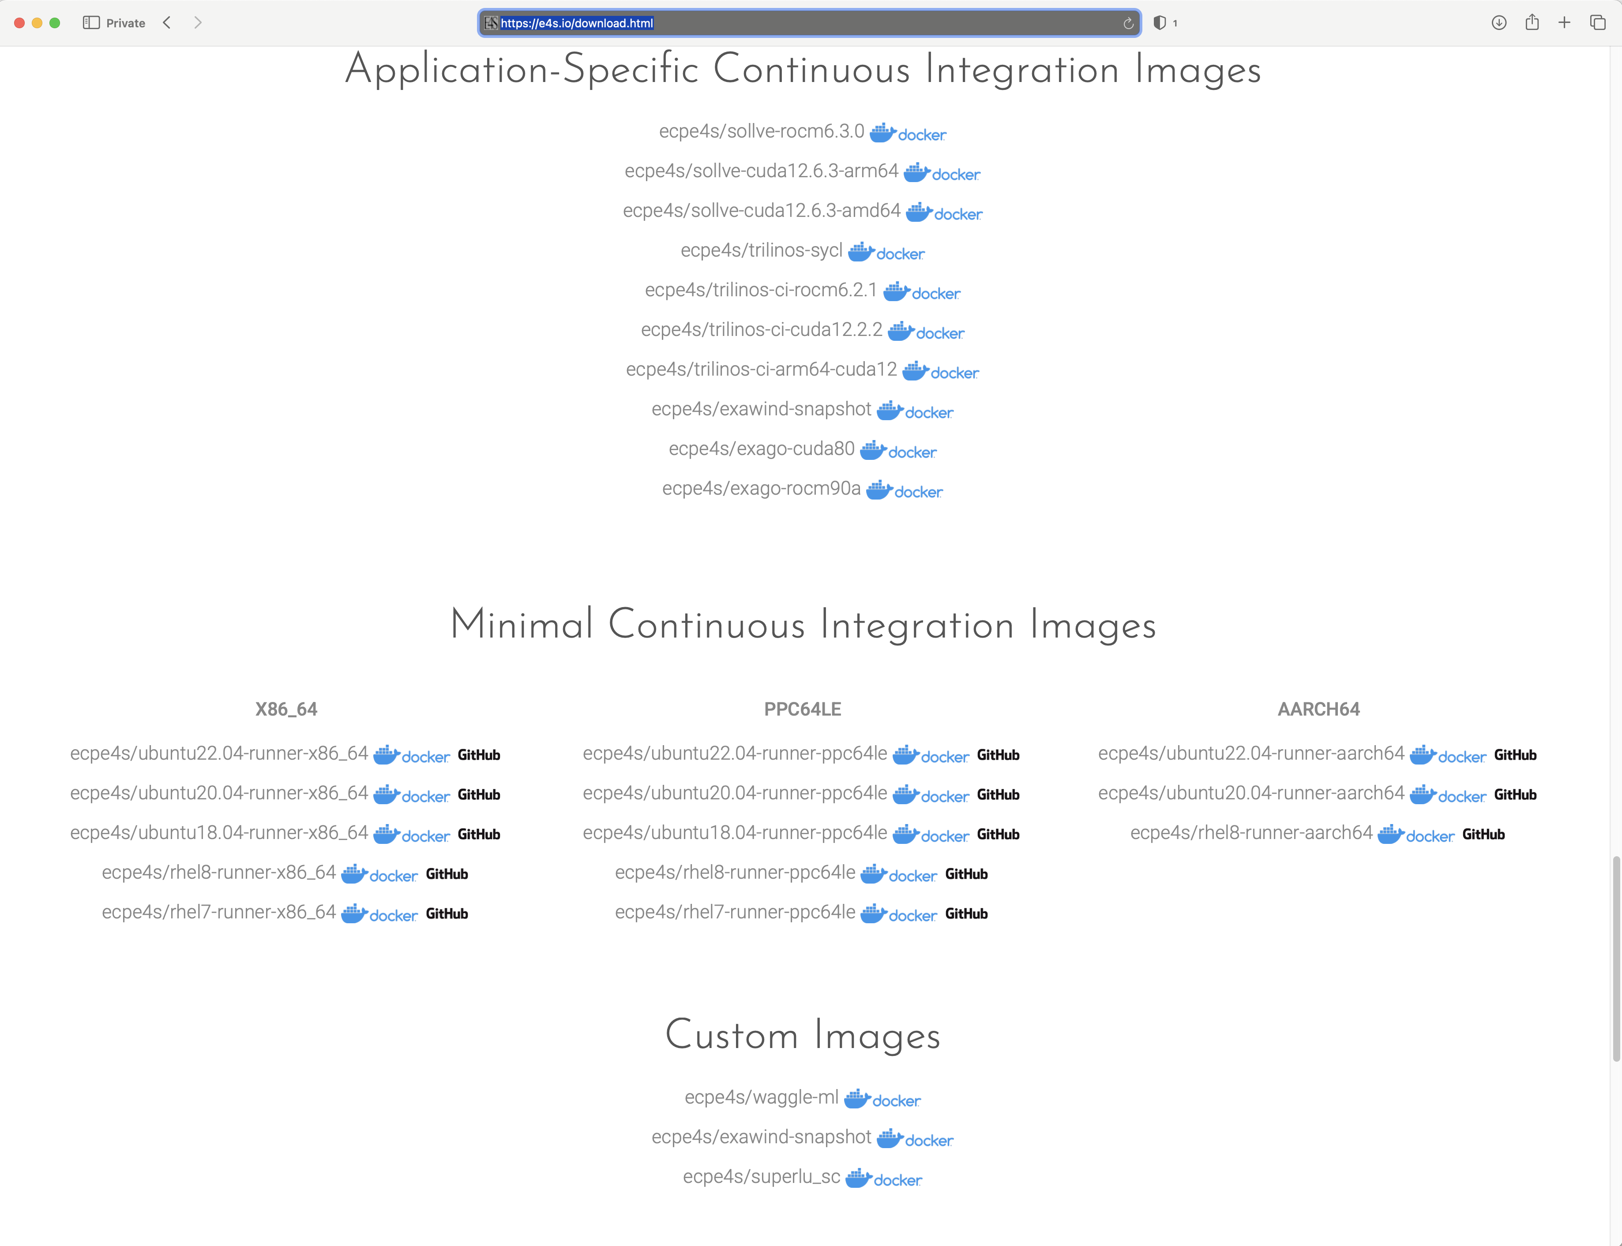
E4S Application Specific CI and minimal CI images
https://e4s.io
Notes:
quick run through - what ECP ST is working on

Slide 9
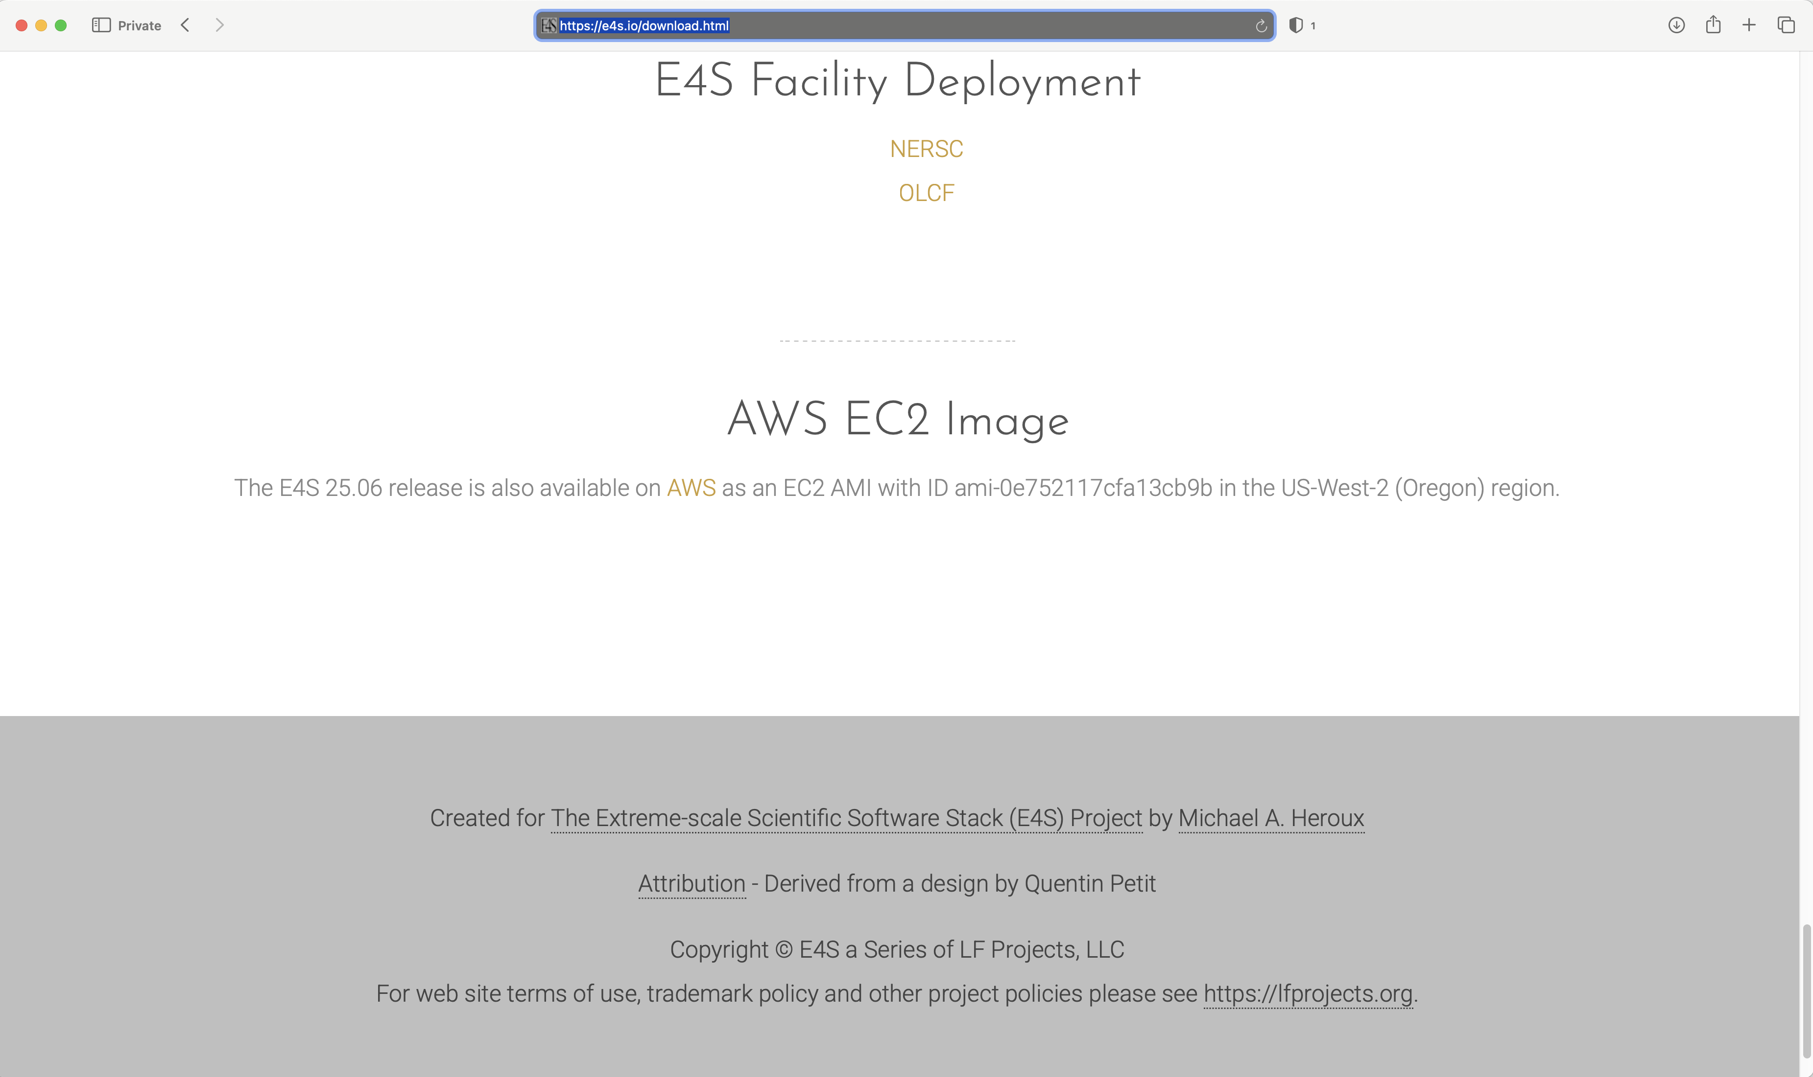
E4S Facility Deployment and AWS EC2 Image
Notes:
quick run through - what ECP ST is working on

Slide 10
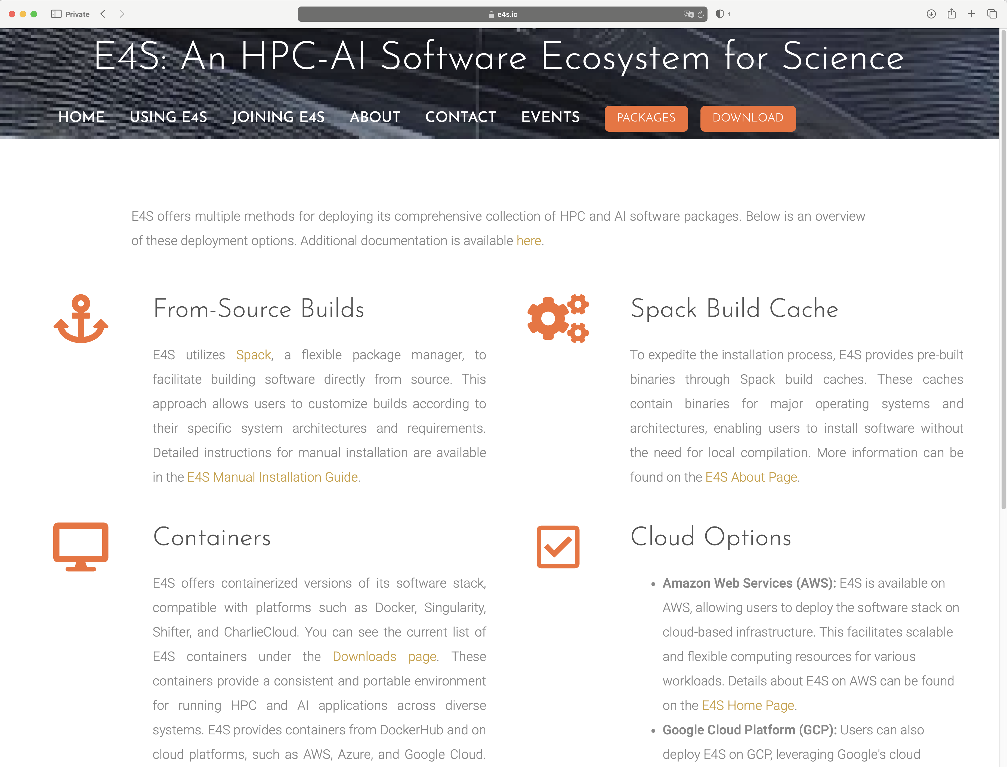
E4S 25.06 Detailed Documentation for Bare-metal Installation
https://e4s.io
Notes:
quick run through - what ECP ST is working on

Slide 11
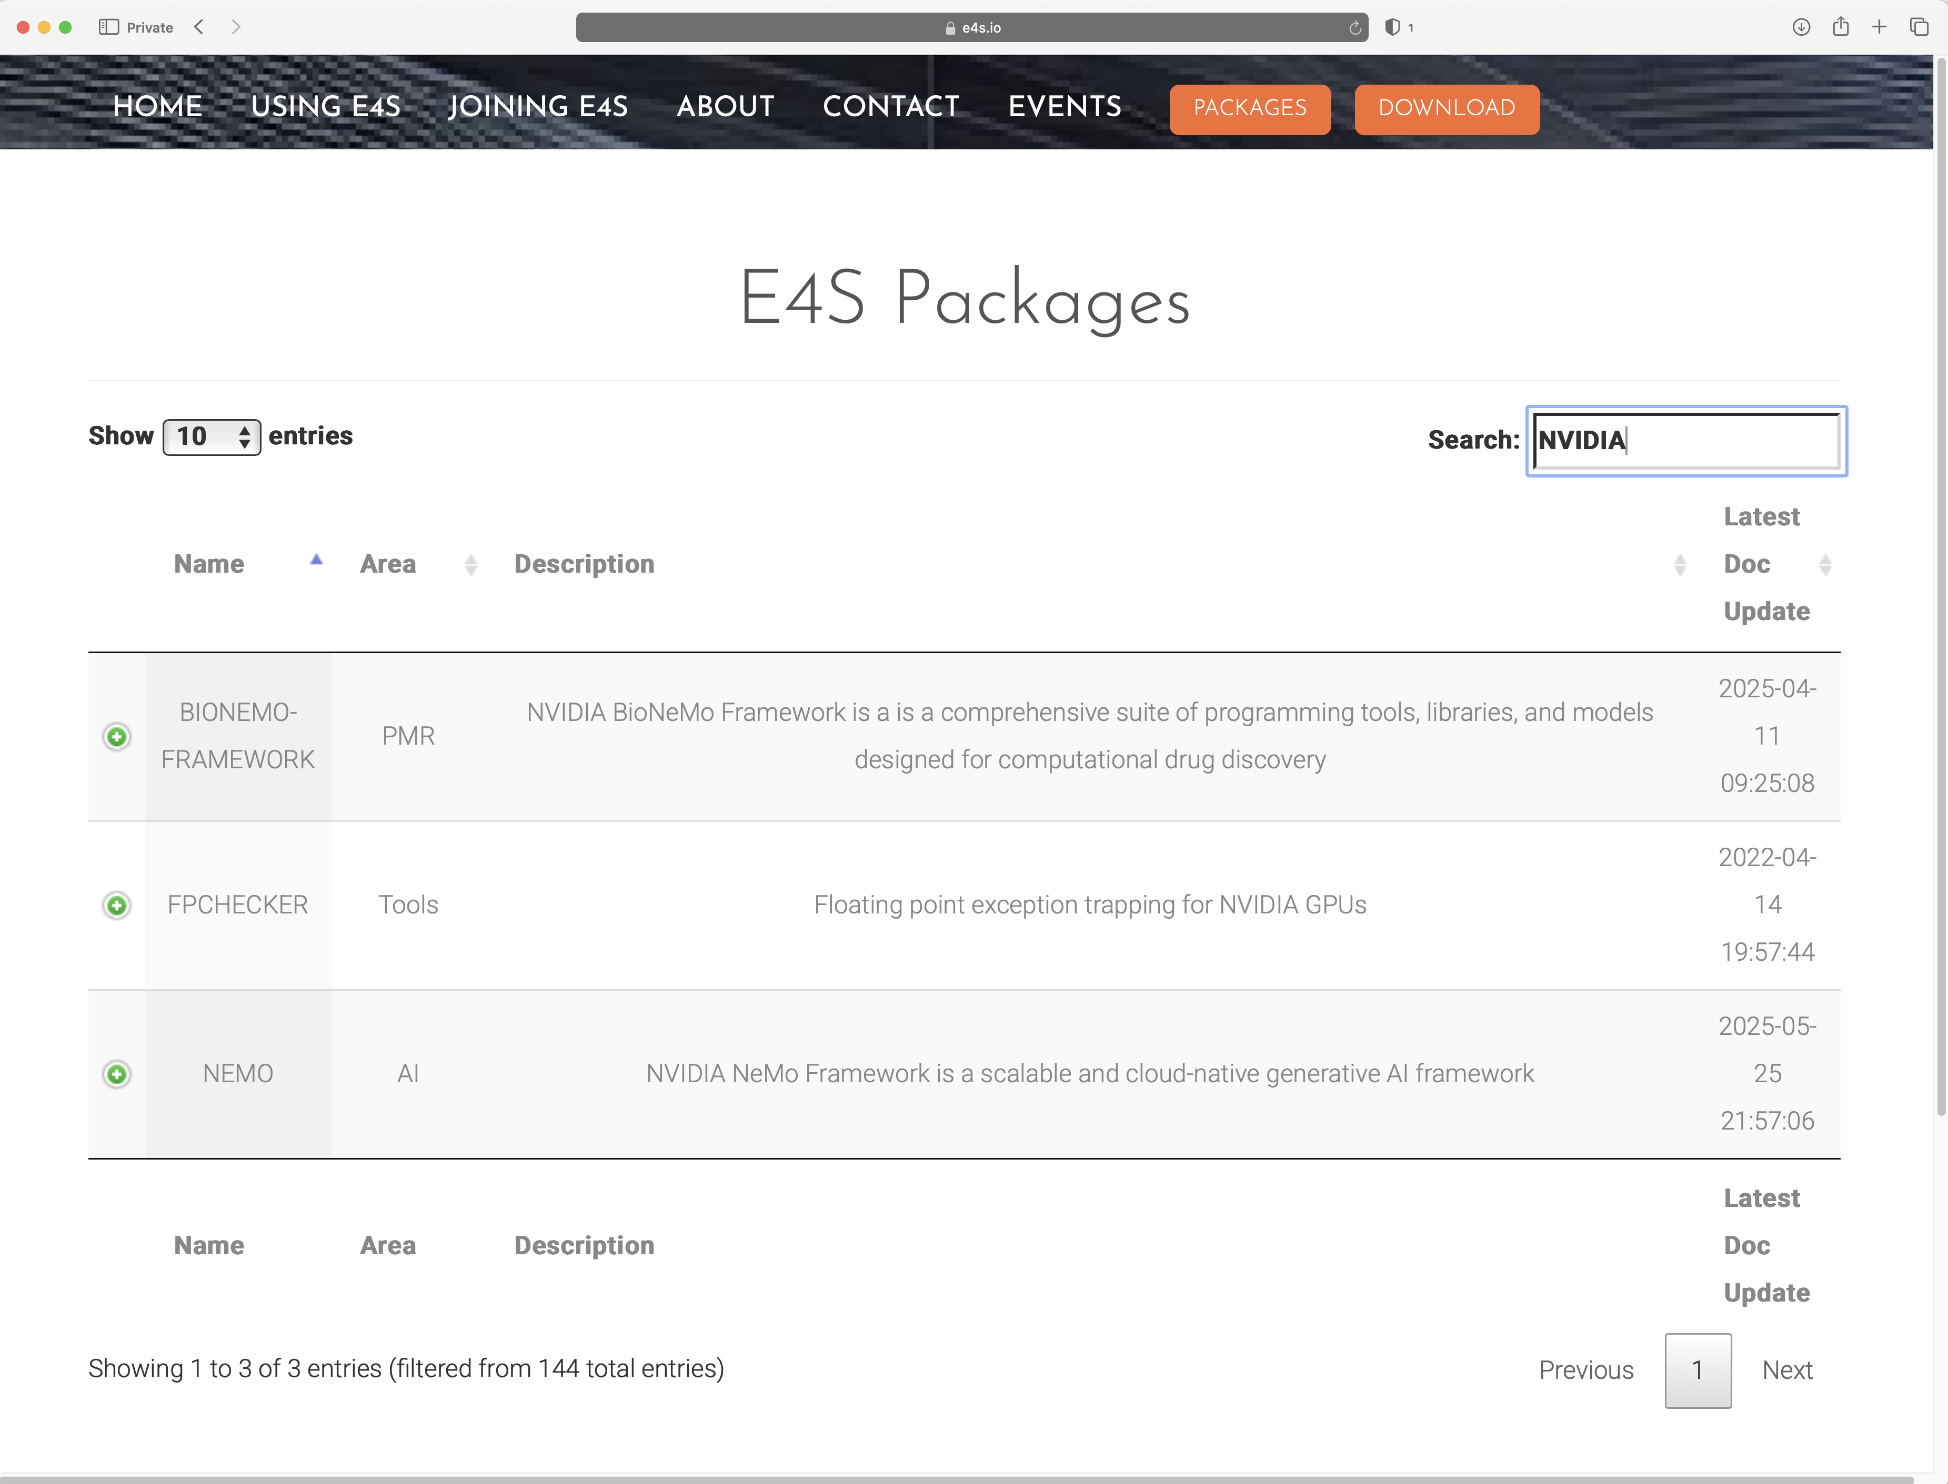
E4S DocPortal updated with new applications and AI/ML tools
https://e4s.io
Notes:
quick run through - what ECP ST is working on

Slide 12
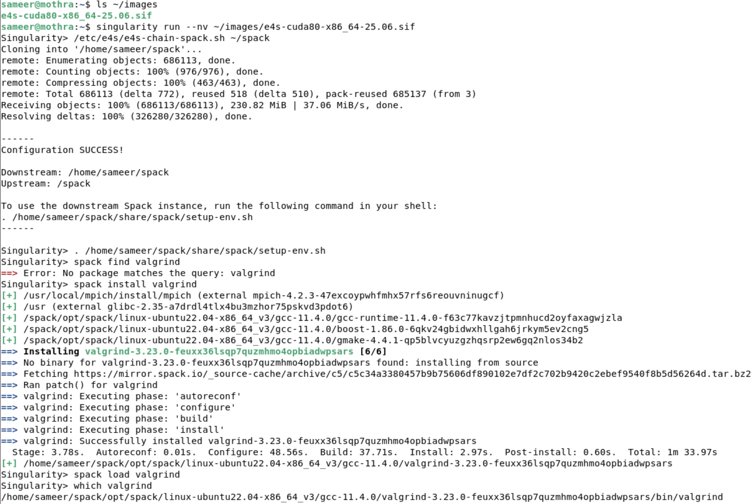
E4S Tools: e4s-chain-spack.sh to customize software stack
Specify location of downstream
Spack installation directory
Source downstream Spack’s setup-env.sh
Install a new Spack package
in downstream Spack directory
Load new package (valgrind)
using spack load
https://e4s.io
Notes:
quick run through - what ECP ST is working on

Slide 13
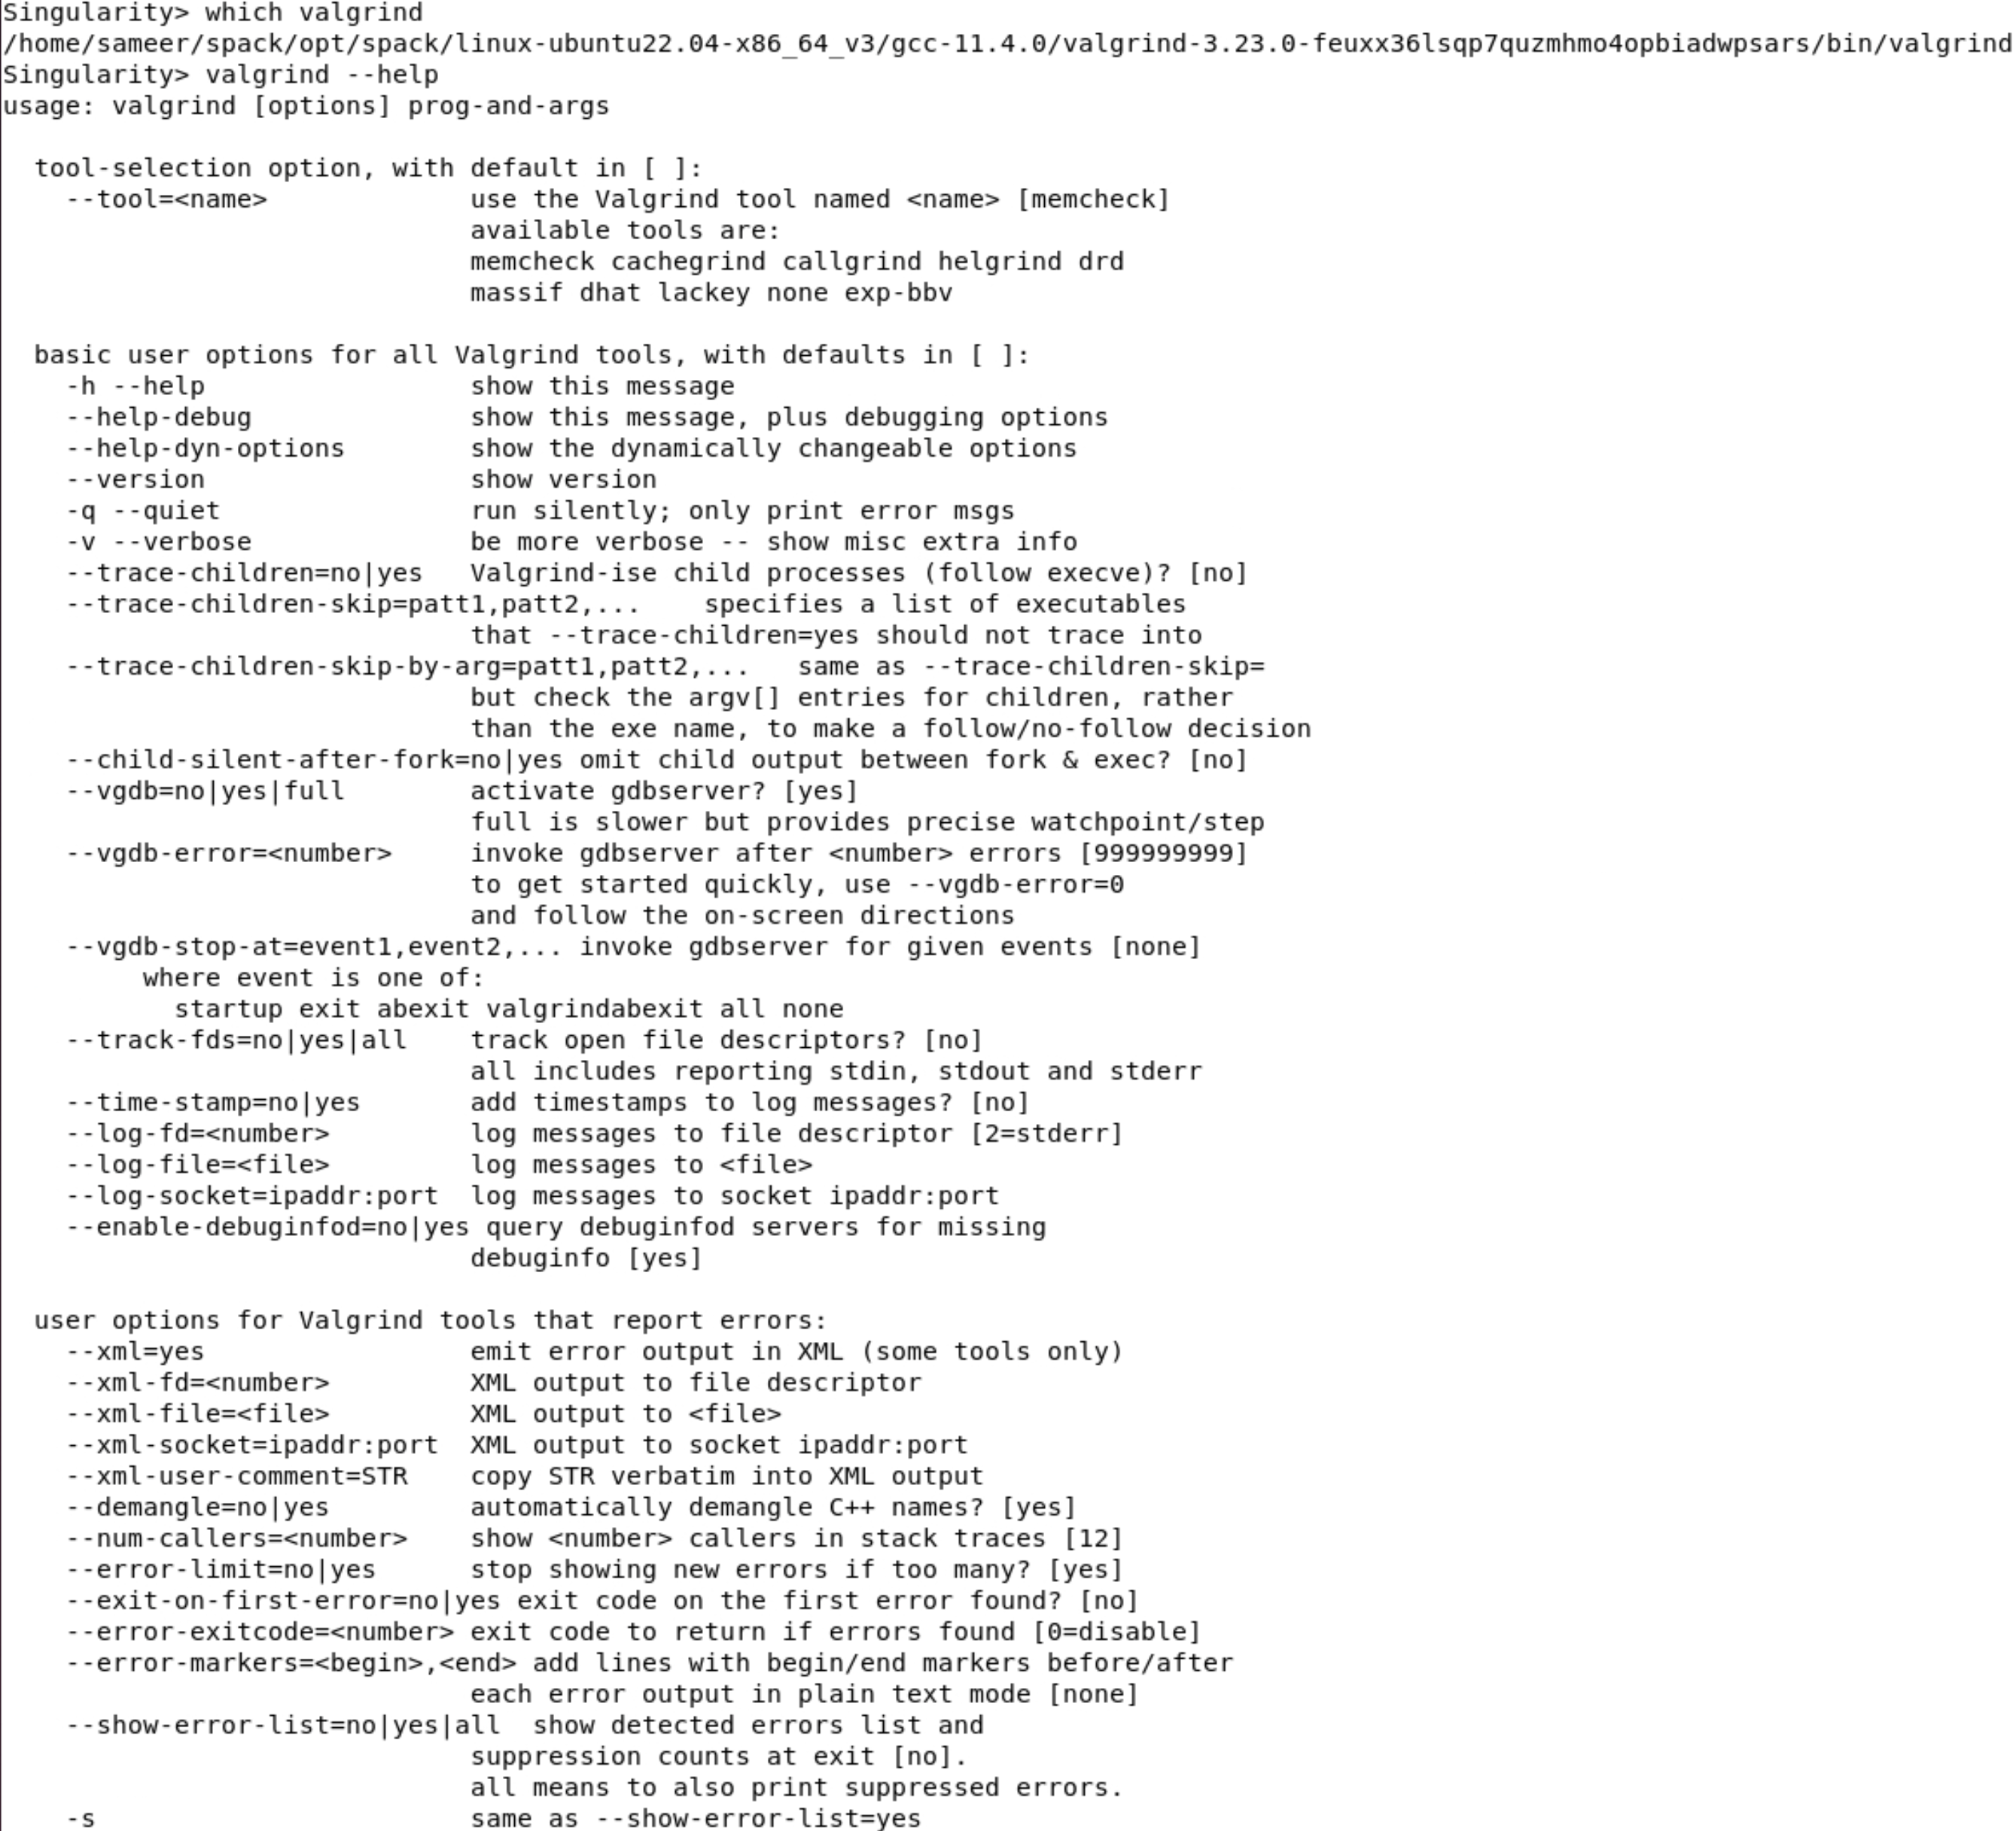
E4S Tools: e4s-chain-spack.sh to customize software stack
Downstream Spack’s package
is loaded in your environment
e4s-chain-spack.sh helps
customize the software stack
using upstream /spack (read-only in the container) for
package dependencies while
installing a new package in the
downstream Spack in your writable home directory.
https://e4s.io
Notes:
quick run through - what ECP ST is working on

Slide 14
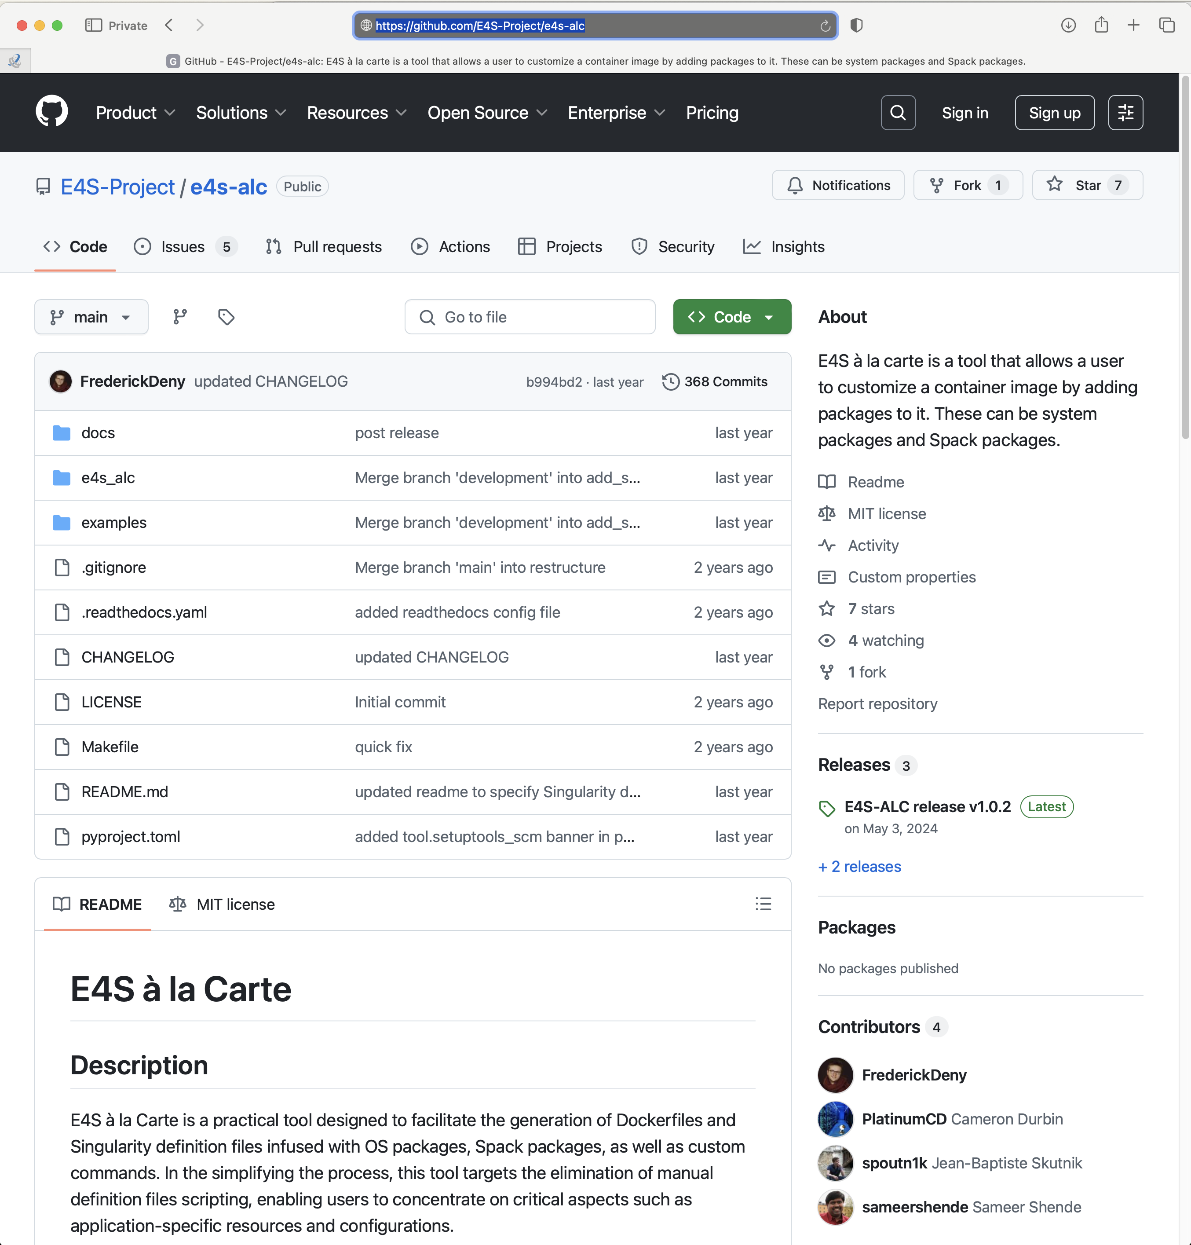
E4S Tools: e4s-alc: Customize container images
Add new system packages
Add new Spack packages
Add new tarballs
Customize the container image
Start with a base image
Add packages
Create a new container image!
https://github.com/E4s-Project/e4s-alc
Notes:
quick run through - what ECP ST is working on

Slide 15
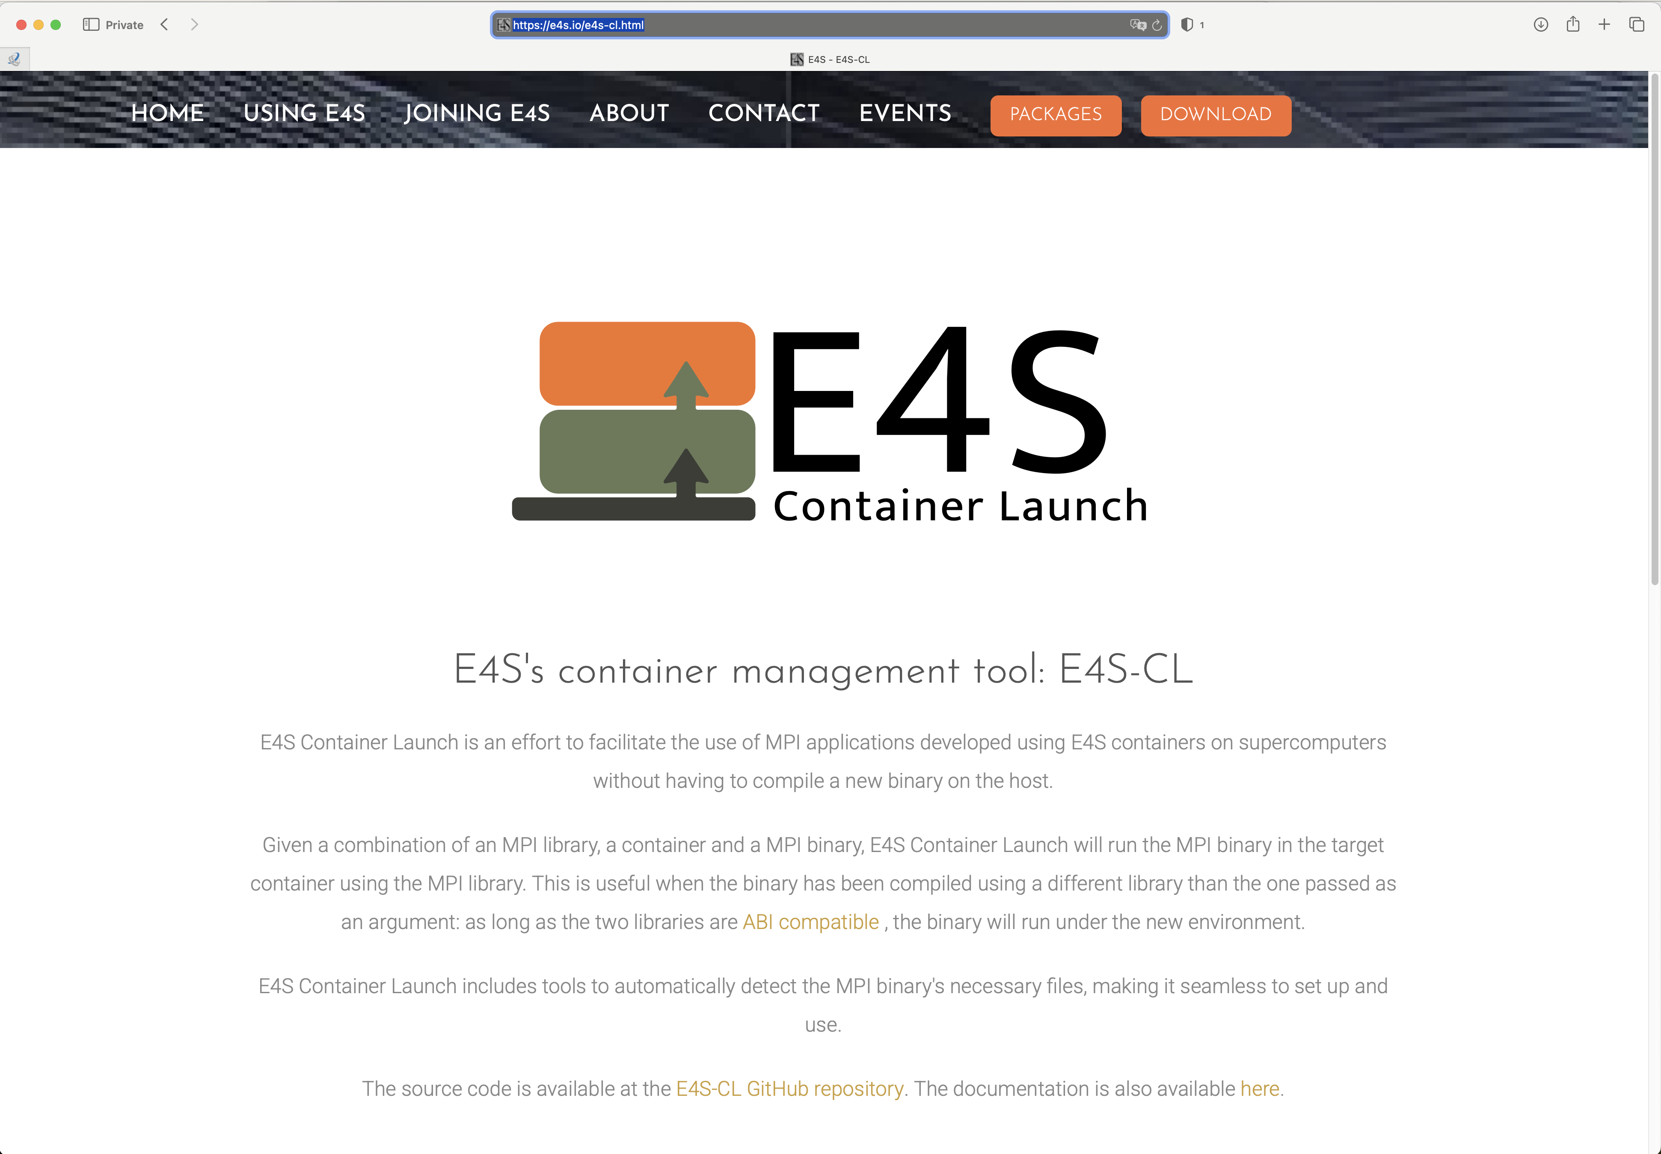
E4S Tools: e4s-cl: Container Launch tool for MPI applications
Distribute your MPI application as a binary with an E4S image
While deploying on a system substitute the embedded containerized MPI in application with the system/vendor MPI
Use inter-node network interfaces efficiently for near native performance!
https://e4s.io/e4s-cl.html
Notes:
quick run through - what ECP ST is working on

Slide 16
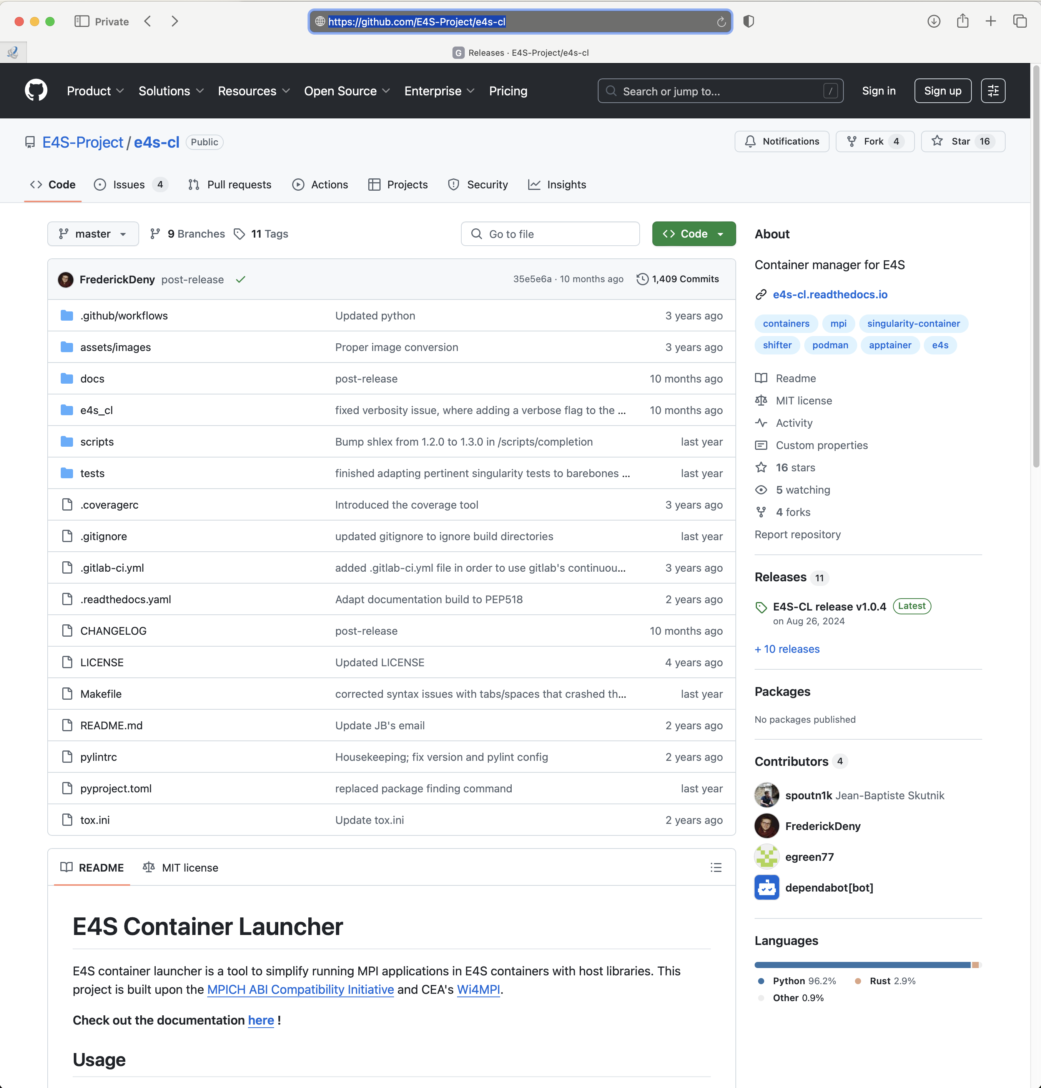

e4s-cl: A tool to simplify the launch of MPI jobs in E4S containers
https://github.com/E4S-Project/e4s-cl
Notes:
quick run through - what ECP ST is working on

Slide 17
e4s-cl: A tool to simplify the launch of MPI jobs in E4S containers
E4S containers support replacement of MPI libraries using MPICH ABI compatibility layer and Wi4MPI [CEA] for OpenMPI replacement.
Applications binaries built using E4S can be launched with Singularity using MPI library substitution for efficient inter-node communications.
e4s-cl is a new tool that simplifies the launch and MPI replacement.
e4s-cl init --backend [singularity|shifter|docker] --image <file> --source <startup_cmds.sh>
e4s-cl mpirun -np <N> <command>
Usage:
% e4s-cl init --backend singularity --image ~/images/e4s-gpu-x86.sif --source ~/source.sh
% cat ~/source.sh
. /spack/share/spack/setup-env.sh
spack load trilinos+cuda cuda_arch=90
% e4s-cl mpirun -np 4 ./a.out
https://github.com/E4S-Project/e4s-cl
Notes:
quick run through - what ECP ST is working on

Slide 18
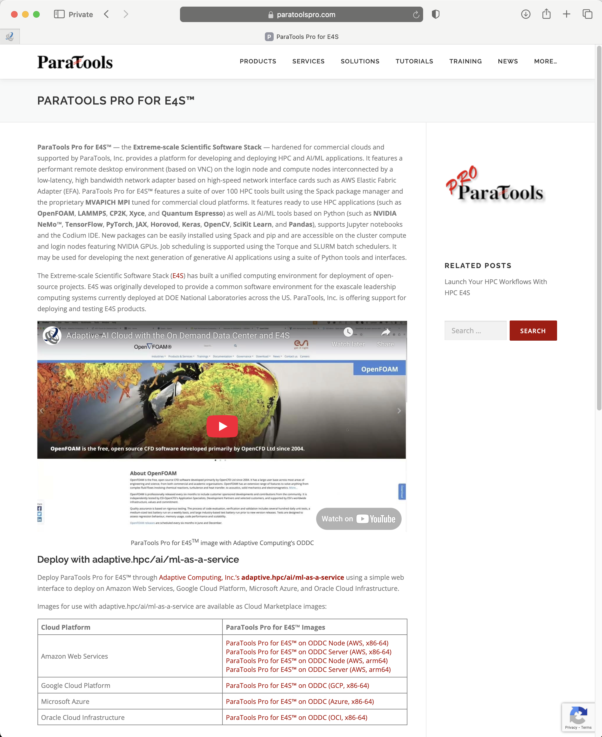

E4S on Commercial Cloud Platforms: ParaTools Pro for E4STM
ParaTools Pro for E4S^{TM*} images in vendor marketplaces support:
AWS
Azure
Google Cloud (GCP)
Oracle Cloud Infrastructure (OCI)
Supports SLURM and Torque for scheduling jobs on multi-node GPU accelerated nodes
Shared GPU accelerated login node with a VNC based remote desktop
Adaptive Computing’s Heidi/ODDC
AWS PCS and PC (x86, ARM64)
Azure Cyclecloud
Google GCluster
* Acknowledgment:
Supported by DOE SBIR Phase I and II DE-SC0022502
https://paratoolspro.com and https://www.energy.gov/technologytransitions/sbirsttr
Notes:
quick run through - what ECP ST is working on

Slide 19
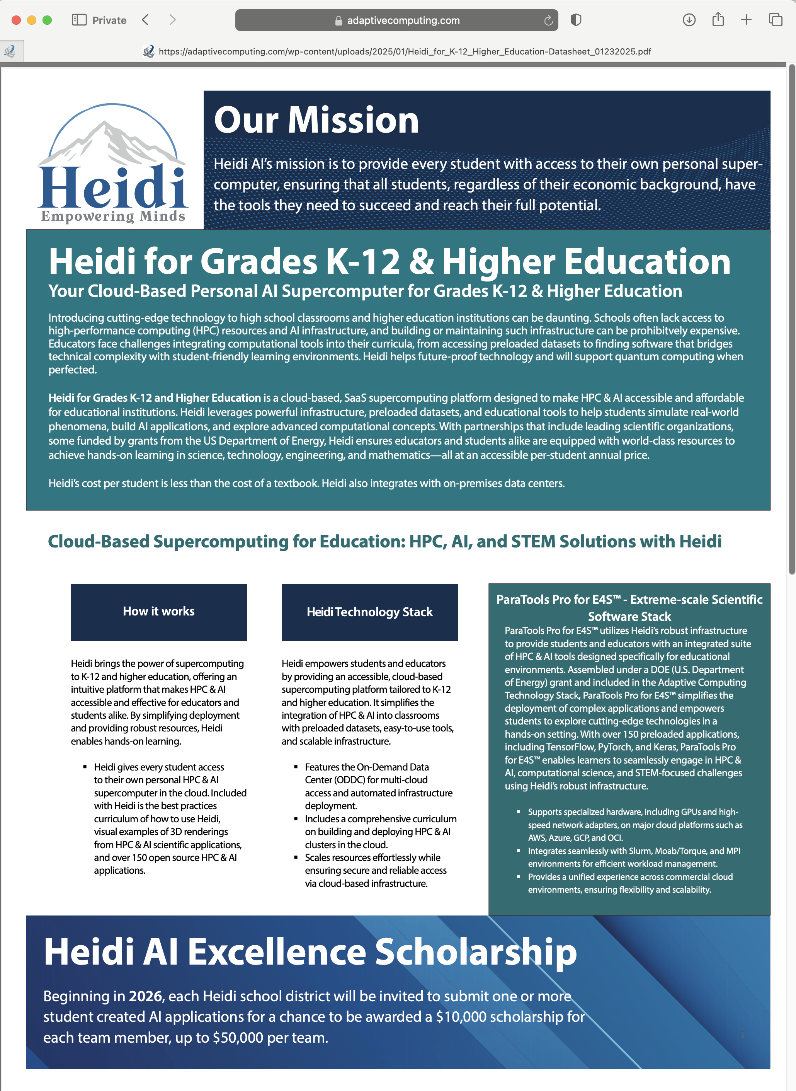
E4S on Adaptive Computing’s Heidi AI/On Demand Data Center (ODDC)
ParaTools Pro for E4STM images in commercial cloud marketplaces launched using Heidi
Supports Torque for scheduling jobs on multi-node GPU accelerated nodes
Shared GPU accelerated login node with a VNC based remote desktop
https://adaptivecomputing.com
Notes:
quick run through - what ECP ST is working on

Slide 20
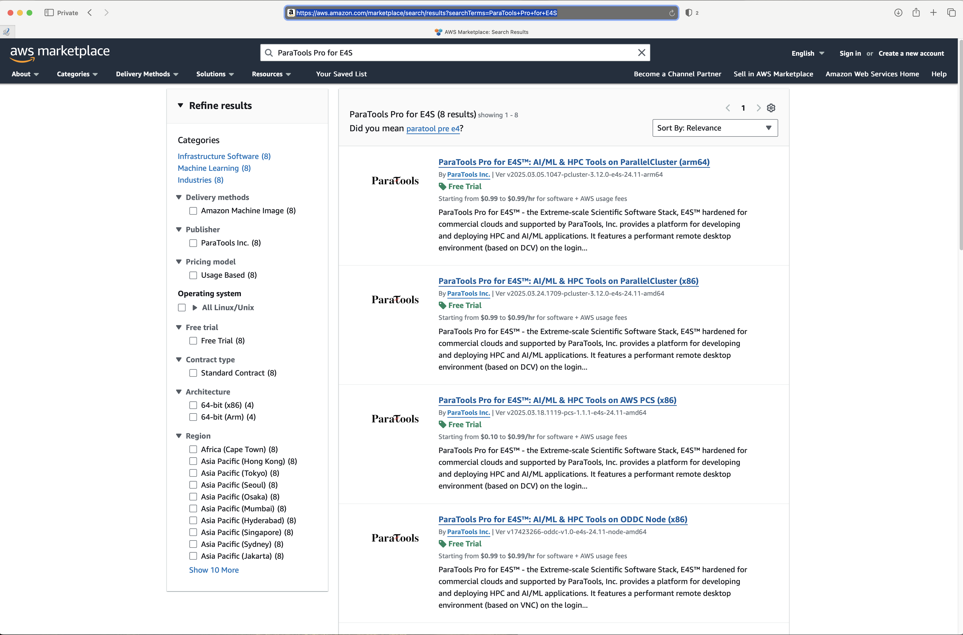
ParaTools Pro for E4STM on Commercial Clouds: AWS Marketplace
ParaTools Pro for E4STM on AWS supports
AWS Trainium and Inferentia custom AI hardware with NeuronX SDK
AWS PCS and PC on x86_64 and aarch64 nodes
NVIDIA GPUs
SLURM (PCS and PC) and Torque (ODDC node/server)
Also on AWS Marketplace in GovCloud (US East & West)
Elastic Fabric Adapter (EFA)
MVAPICH MPI [X-ScaleSolutions, LLC and The Ohio State University]
Notes:
quick run through - what ECP ST is working on

Slide 21
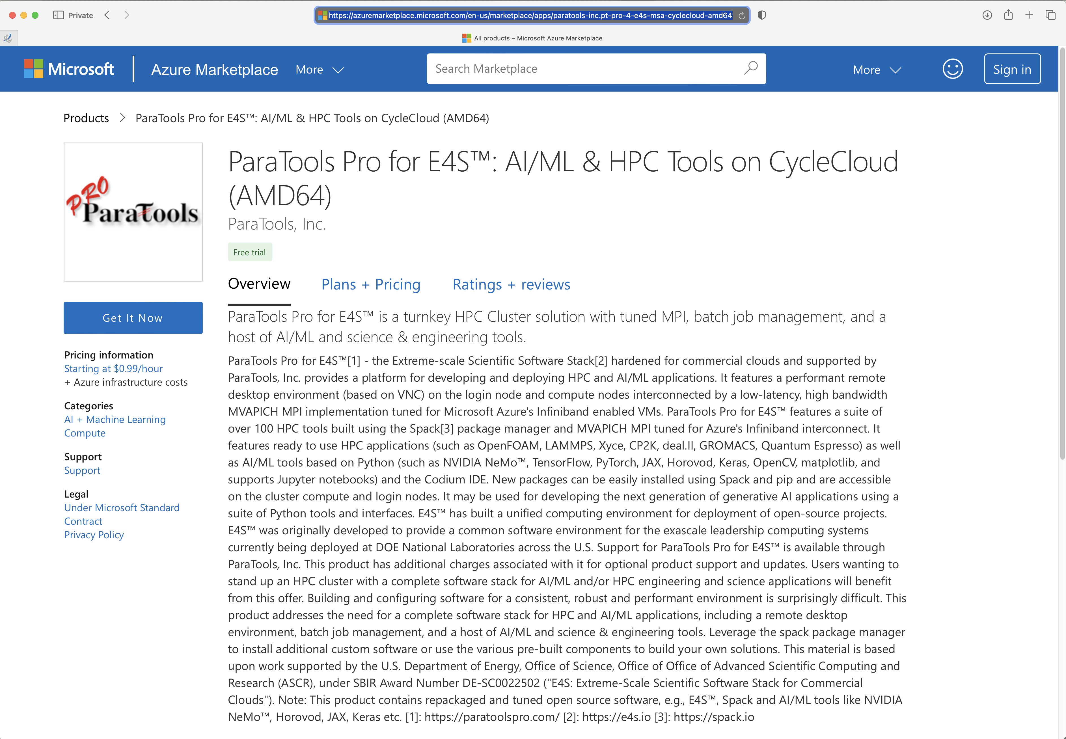
ParaTools Pro for E4STM on Commercial Clouds: Azure Marketplace
ParaTools Pro for E4STM on Azure Marketplace supports
SLURM (Azure CycleCloud) and Torque schedulers (Adaptive Computing’s ODDC)
Support for Infiniband Network adapter
Notes:
quick run through - what ECP ST is working on

Slide 22
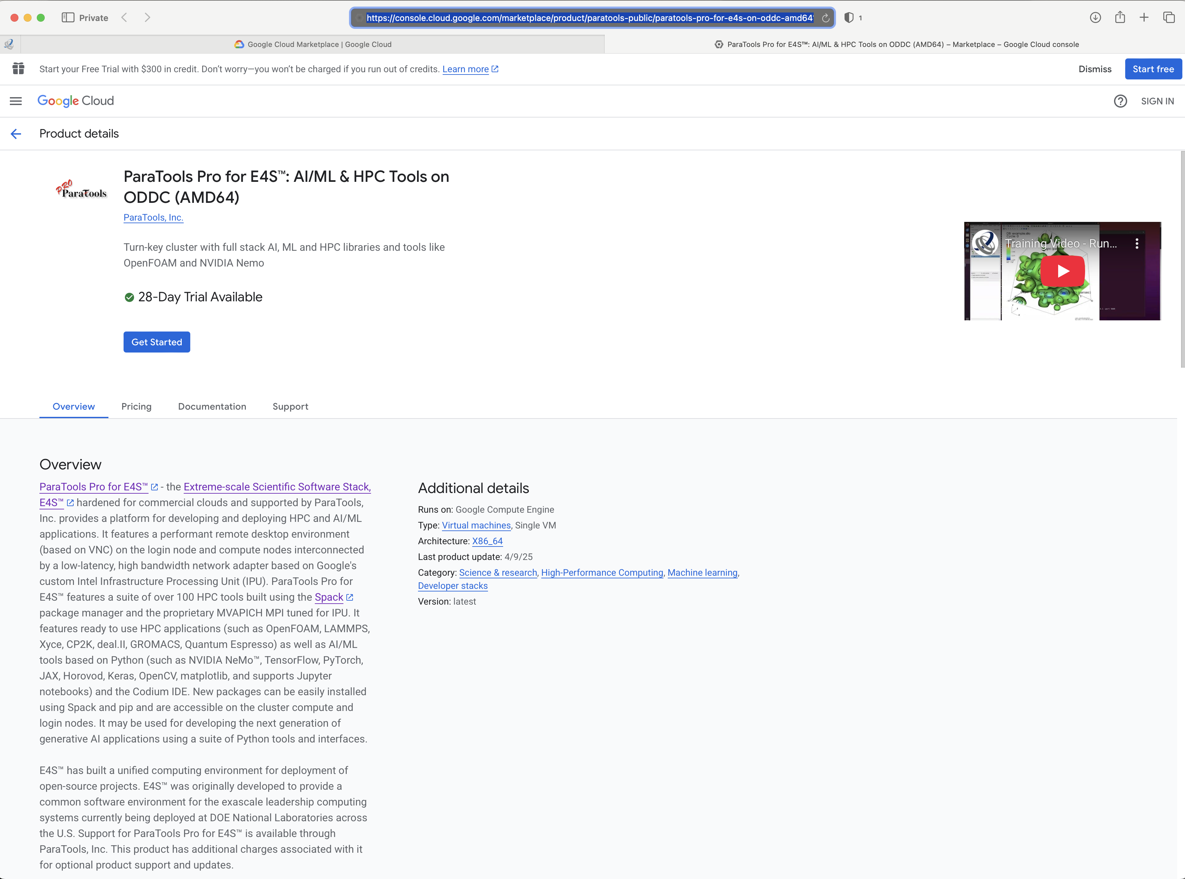
ParaTools Pro for E4STM on Google Cloud Marketplace
ParaTools Pro for E4STM Google Cloud Marketplace supports
SLURM (GCluster) and Torque schedulers (Adaptive Computing’s ODDC)
Support for Google IPU network adapters
Notes:
quick run through - what ECP ST is working on

Slide 23
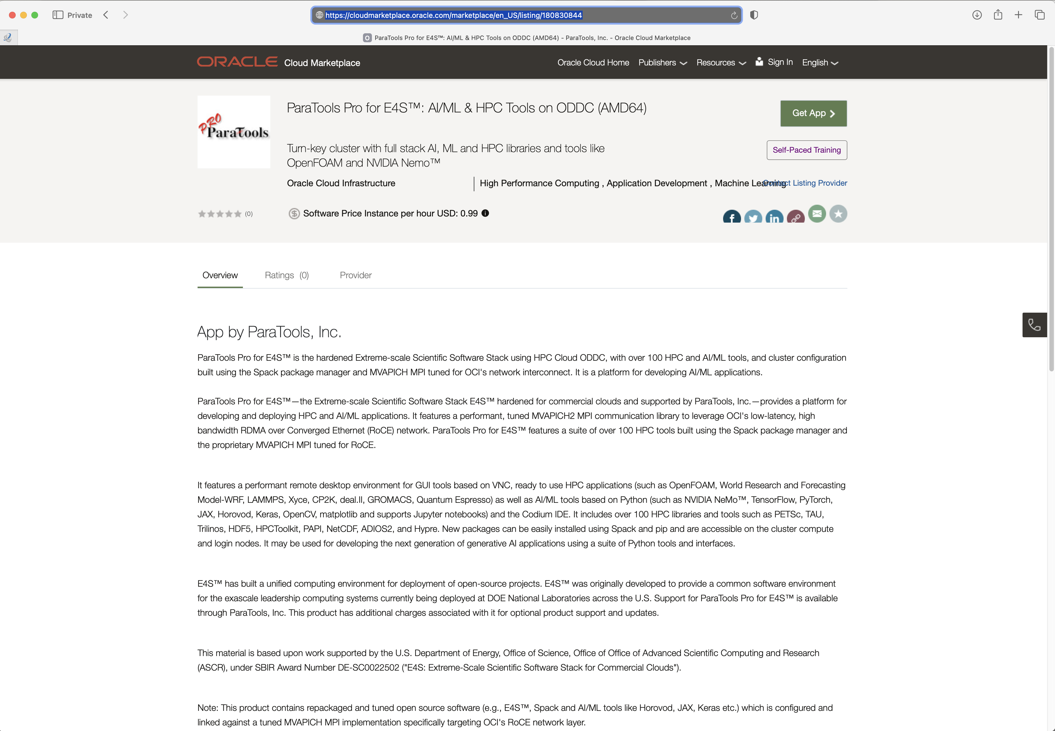
ParaTools Pro for E4STM on Oracle Cloud Marketplace
ParaTools Pro for E4STM for Oracle Cloud Infrastructure (OCI) Marketplace supports Torque (ODDC) and
RDMA over Converged Ethernet (RoCE) network adapters and GPUs on login and compute nodes
Notes:
quick run through - what ECP ST is working on

Slide 24
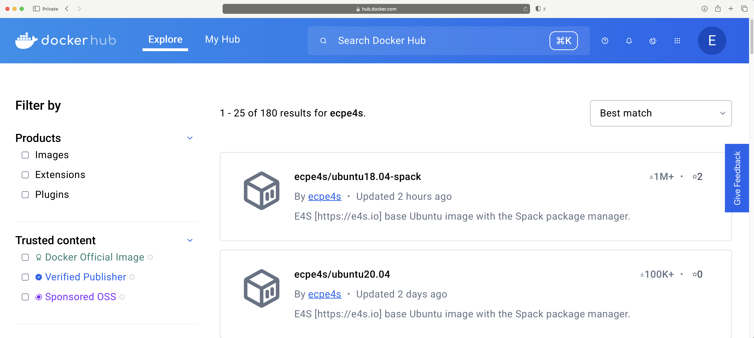
E4S 25.06 Release on DockerHub: Base images
https://e4s.io
Notes:
quick run through - what ECP ST is working on

Slide 25
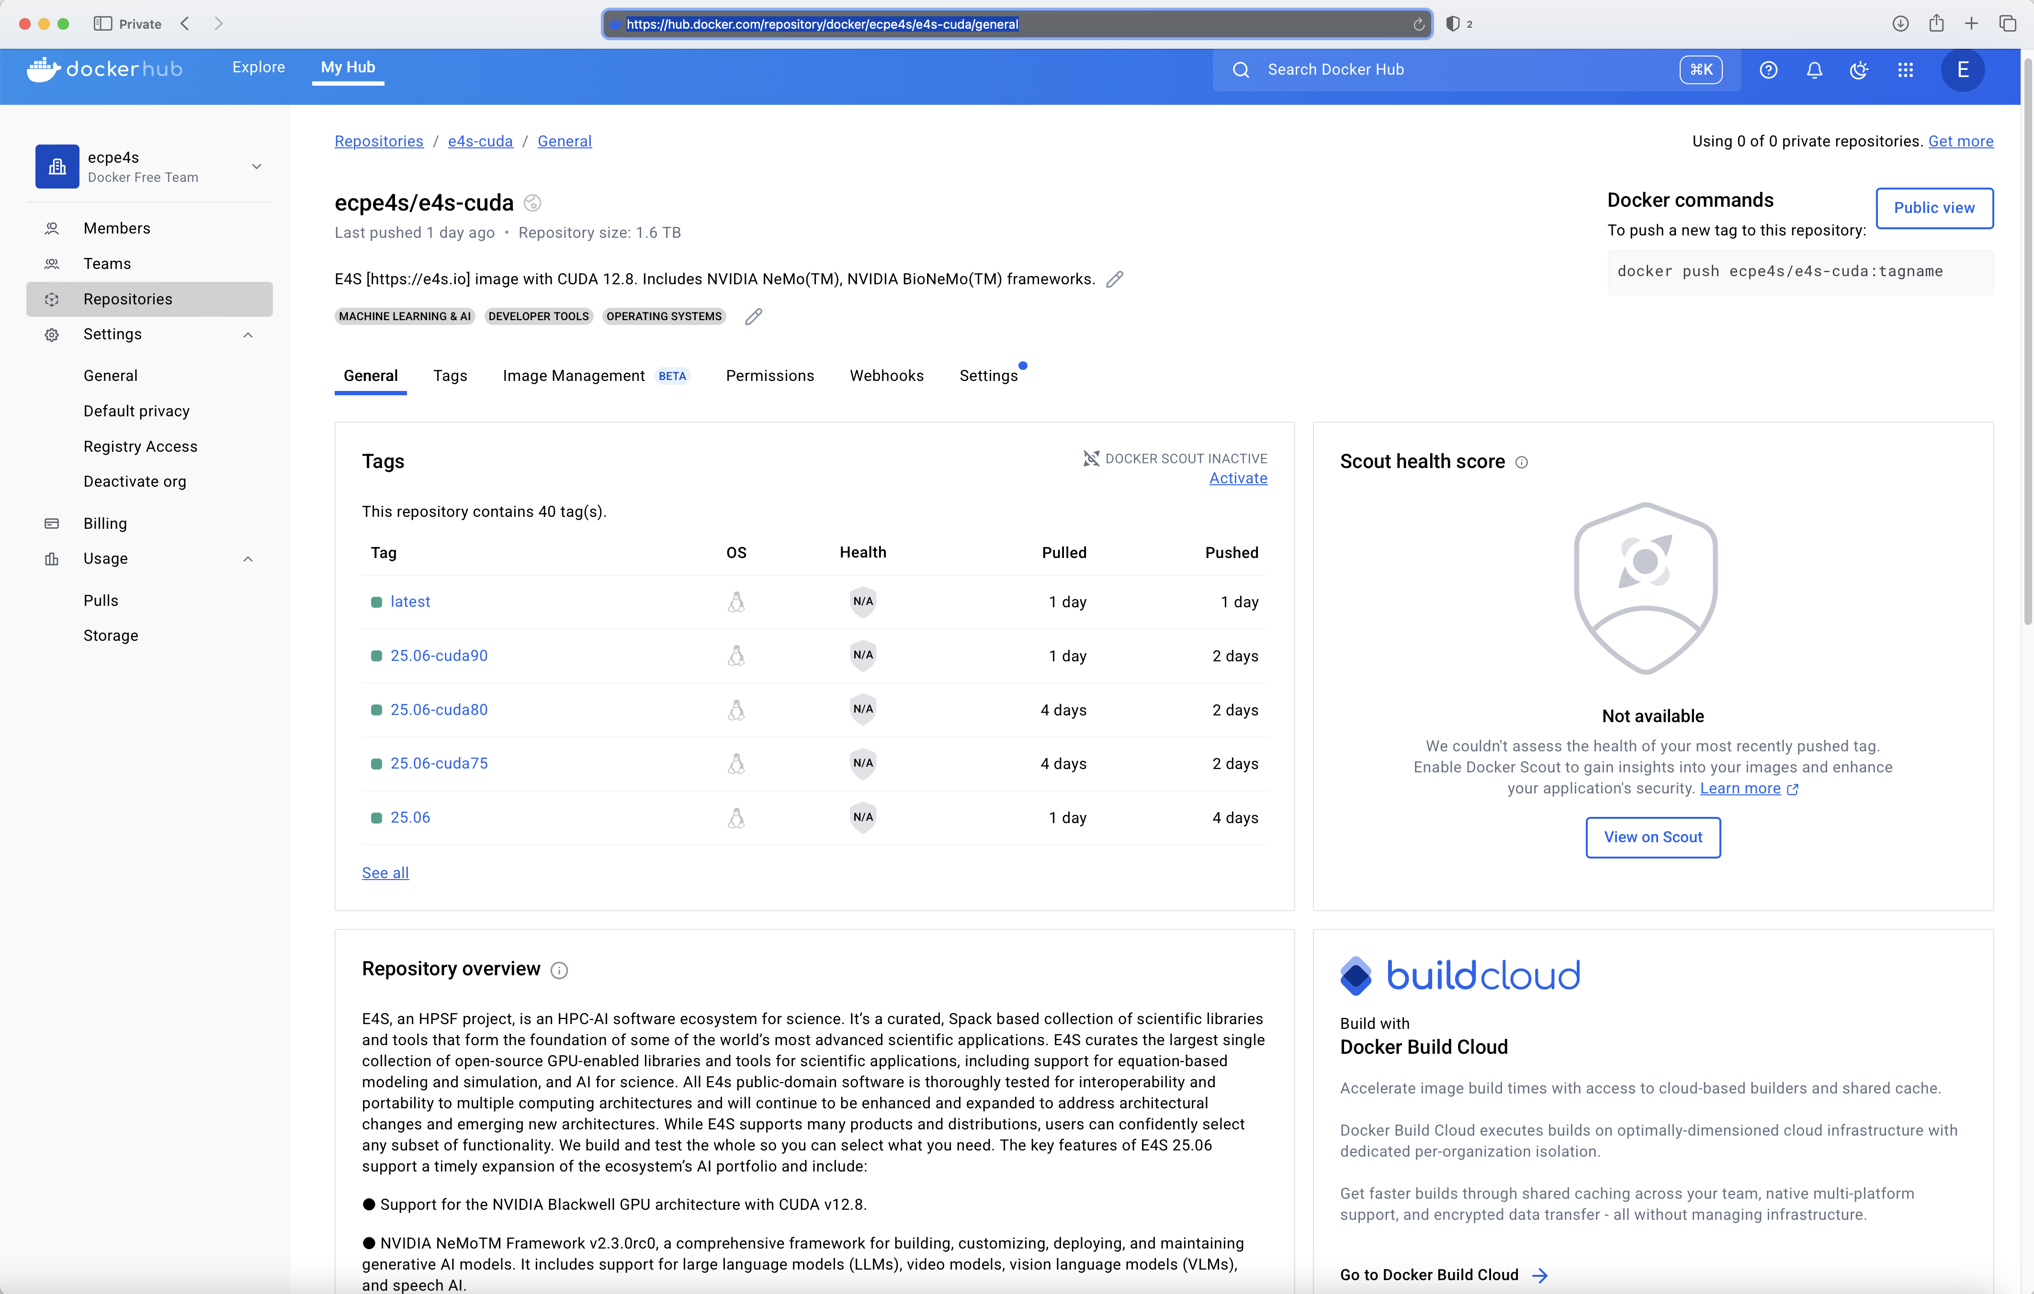
E4S 25.06 Release on DockerHub: Full Featured CUDA image
https://e4s.io
Notes:
quick run through - what ECP ST is working on

Slide 26
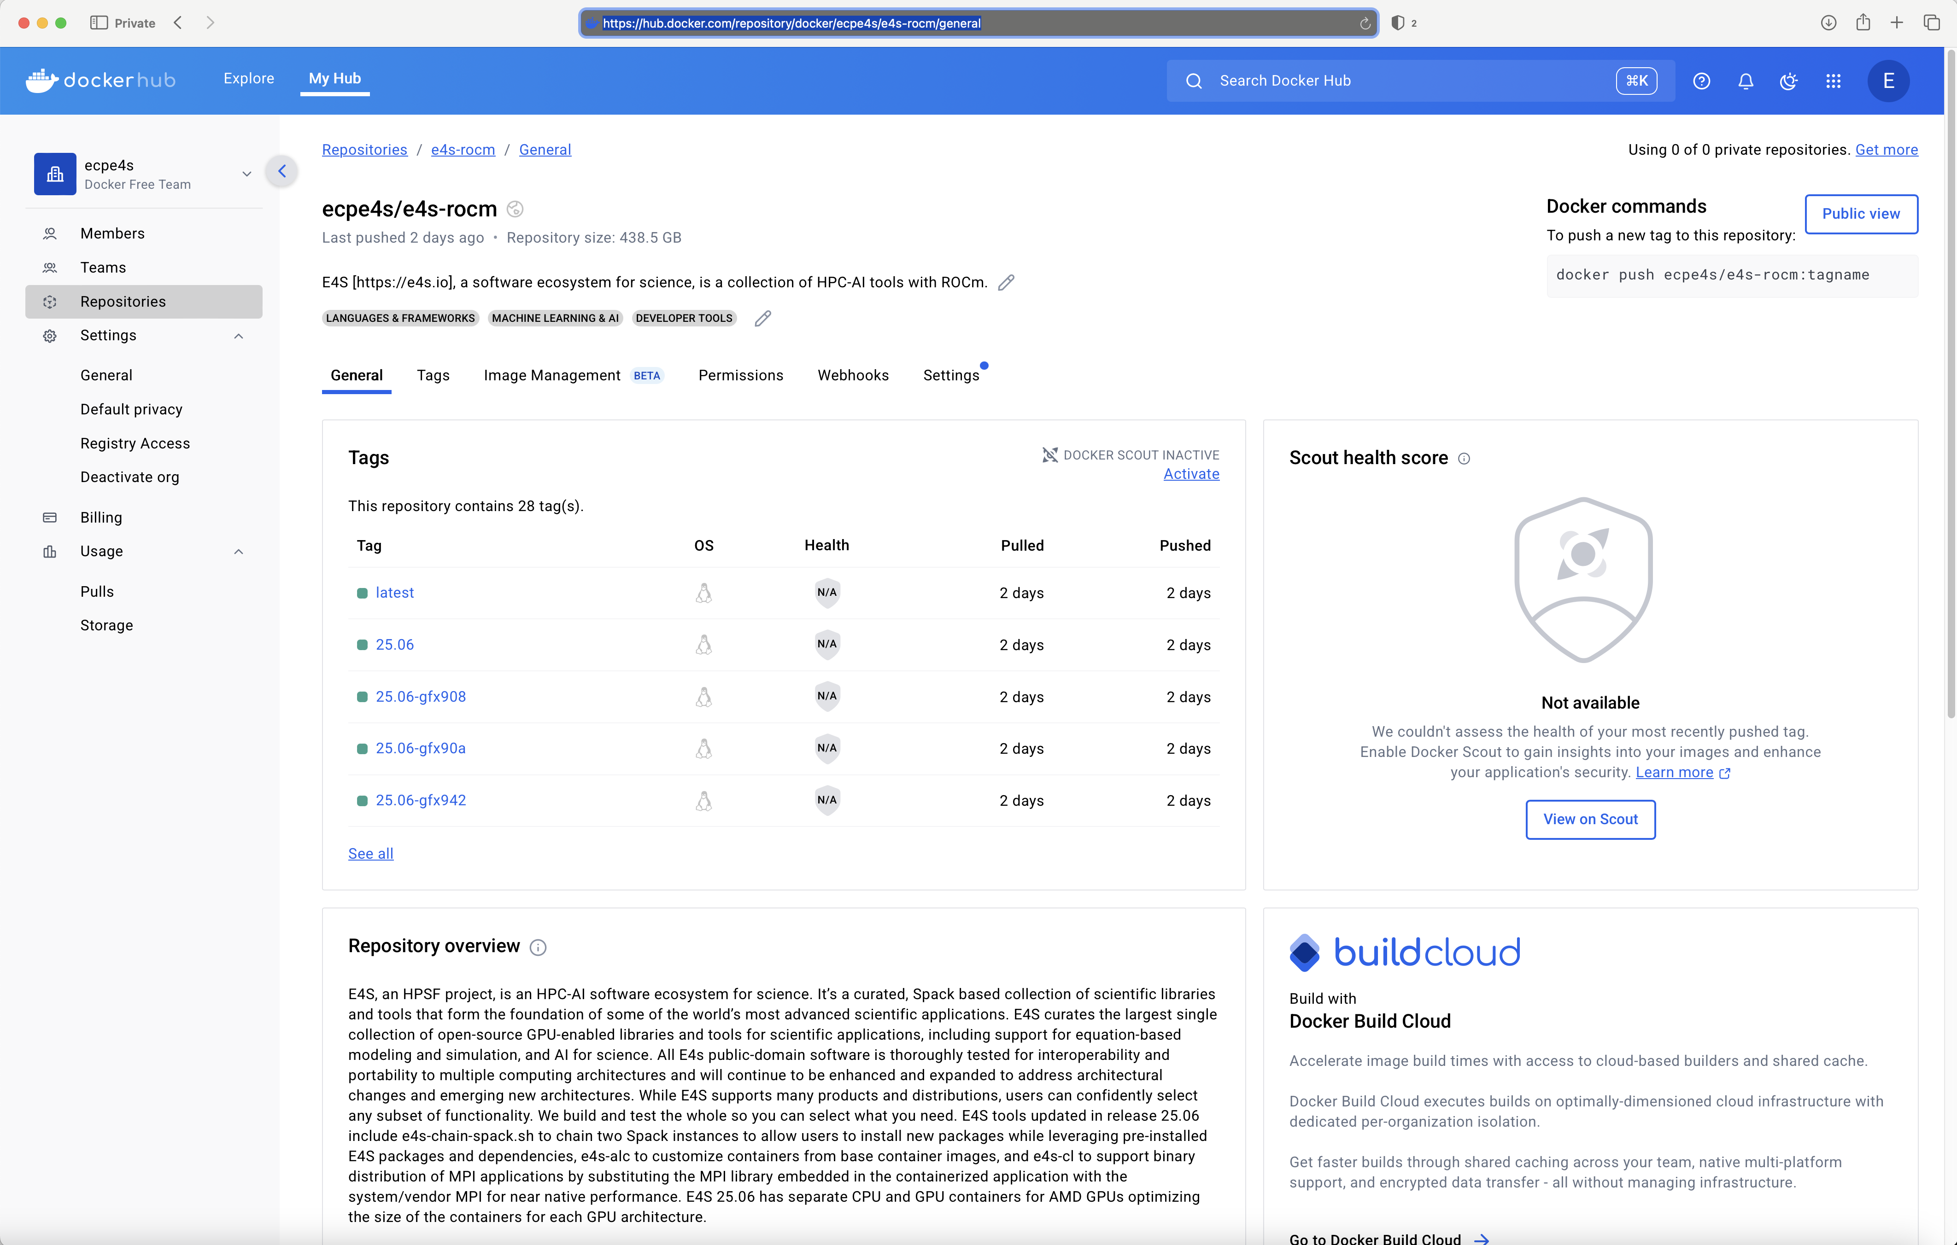
E4S 25.06 Release on DockerHub: Full Featured ROCm image
https://e4s.io
Notes:
quick run through - what ECP ST is working on

Slide 27
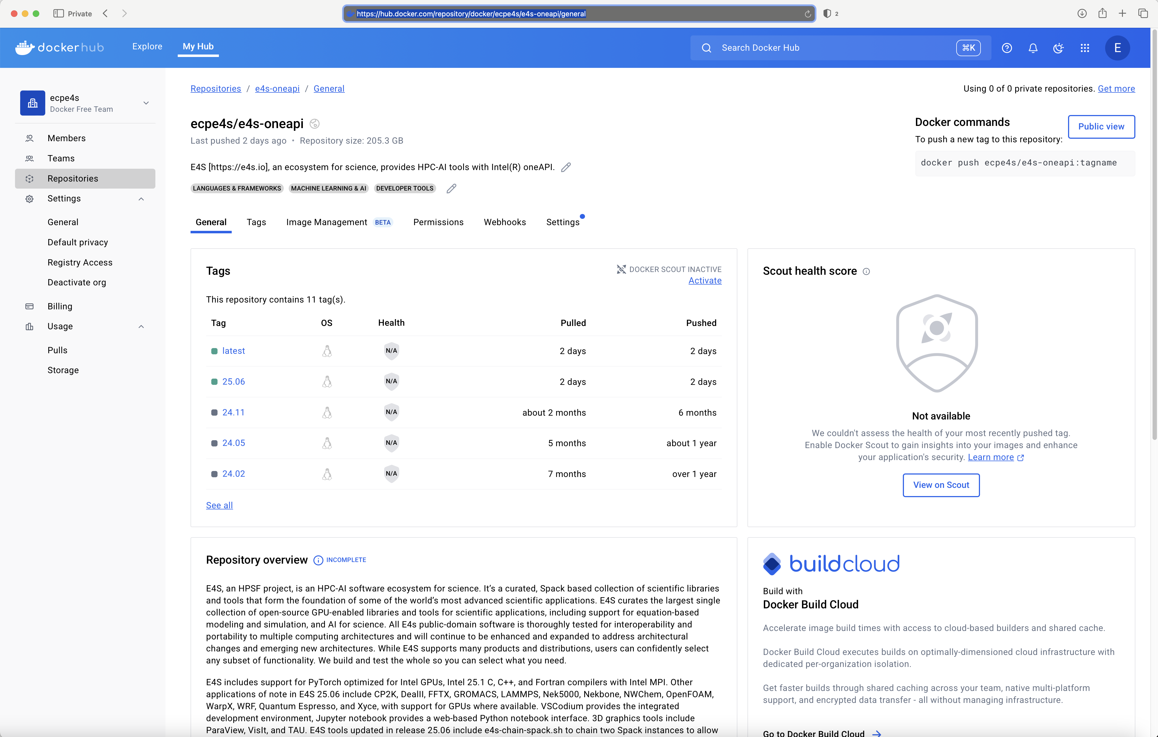
E4S 25.06 Release on DockerHub: Full Featured oneAPI image
https://e4s.io
Notes:
quick run through - what ECP ST is working on

Slide 28
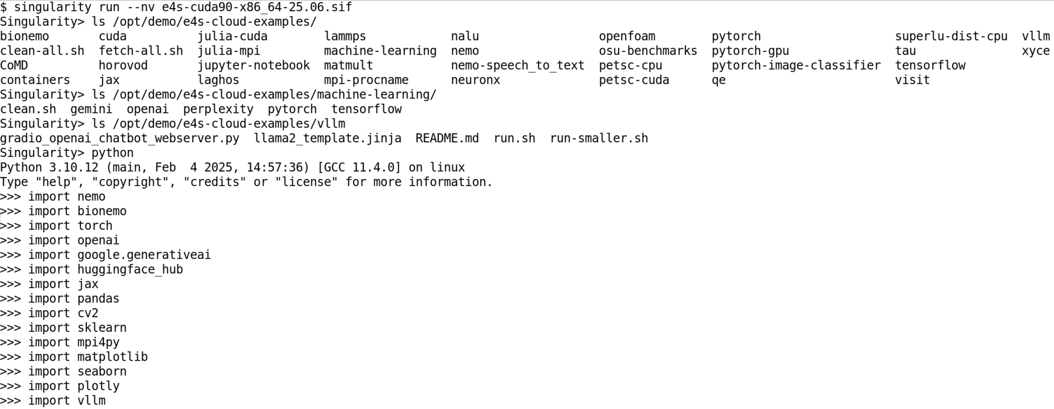
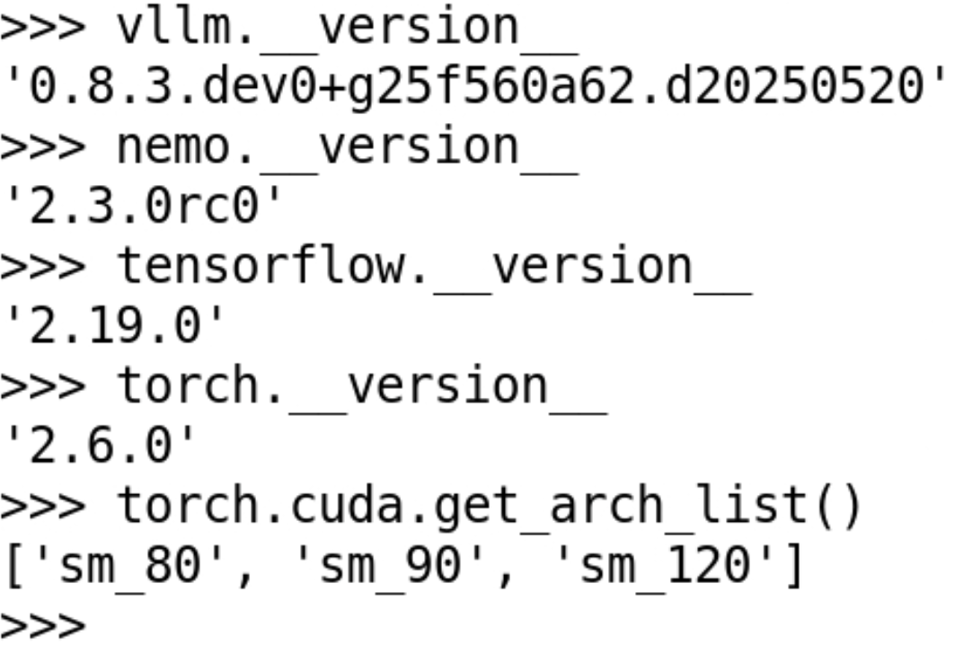
E4S 25.06 image for NVIDIA H100 GPU on x86_64
https://e4s.io
Notes:
quick run through - what ECP ST is working on

Slide 29
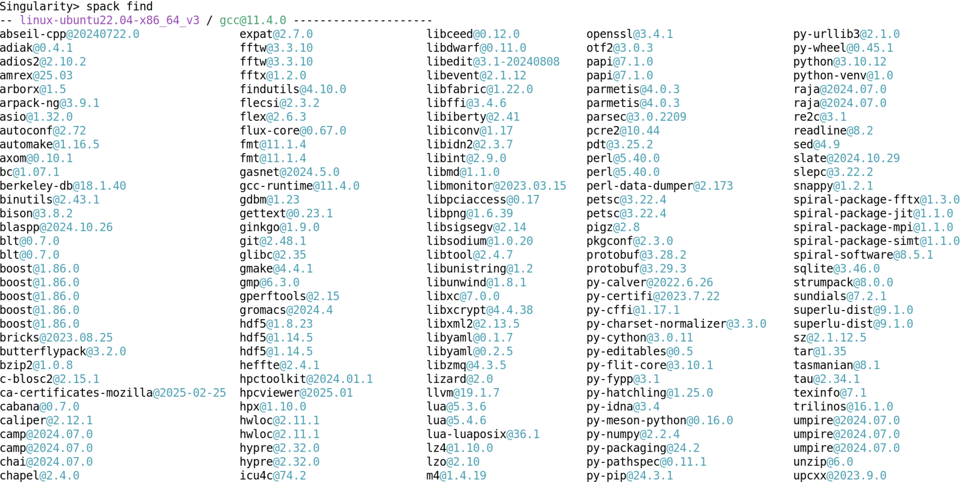
E4S 25.06 image for NVIDIA GPUs (x86_64)
https://e4s.io
Notes:
quick run through - what ECP ST is working on

Slide 30
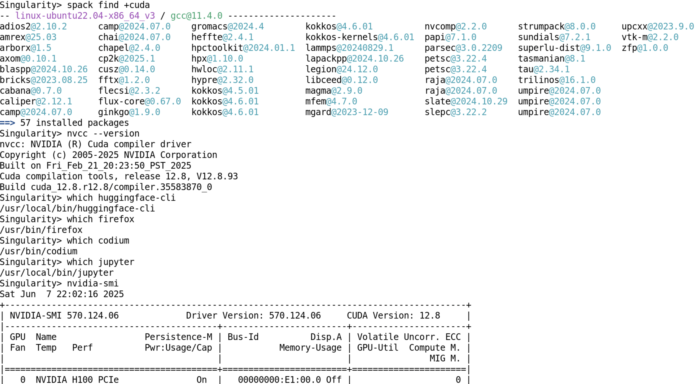
E4S 25.06 image for NVIDIA GPUs (x86_64)
https://e4s.io
Notes:
quick run through - what ECP ST is working on

Slide 31
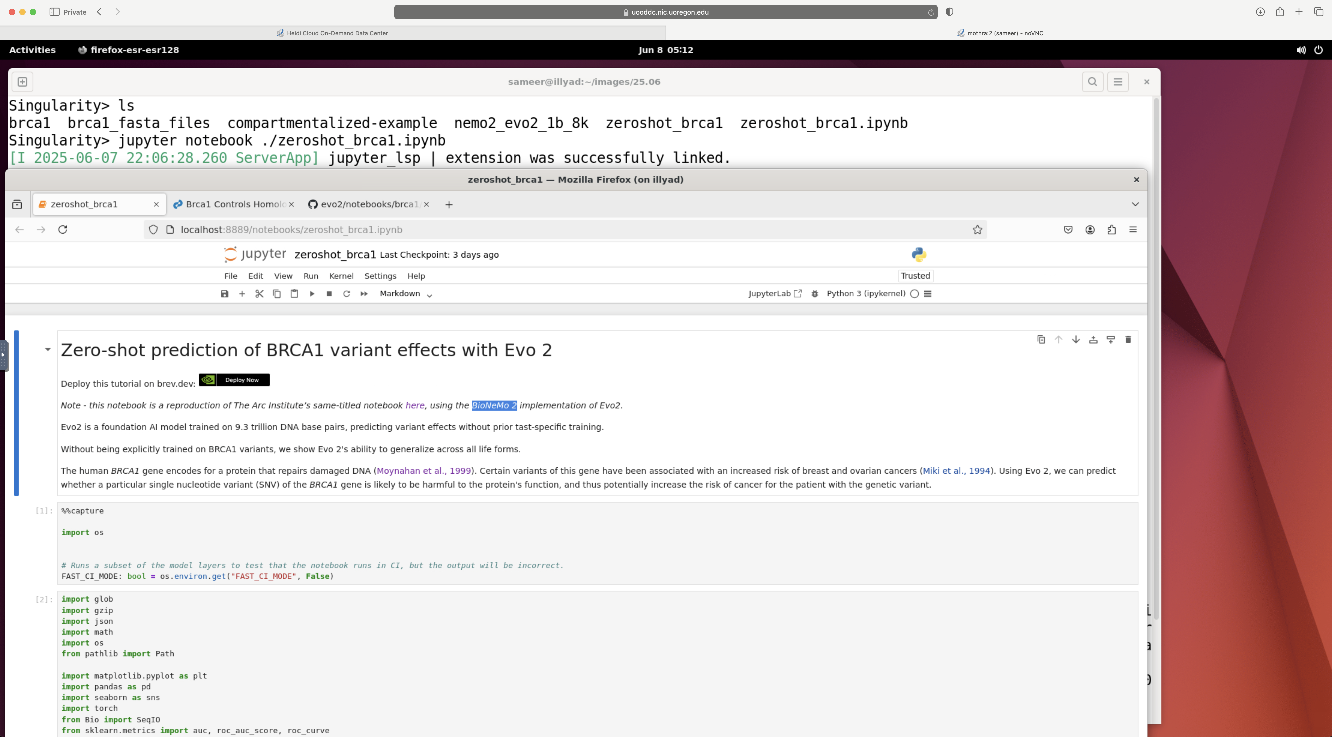
NVIDIA® BioNeMoTM Framework on E4S 25.06 CUDA x86_64
https://e4s.io
Notes:
quick run through - what ECP ST is working on

Slide 32
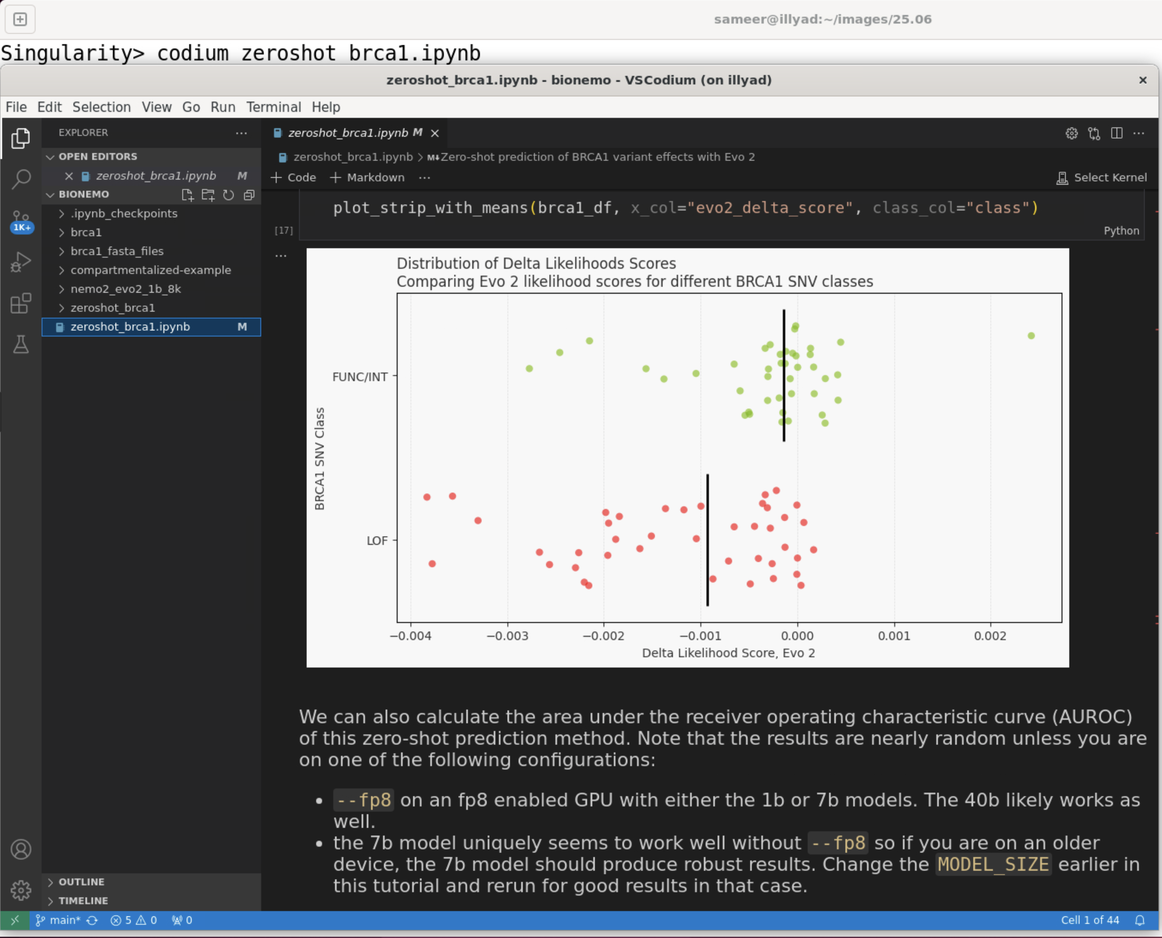
E4S 25.06 image for CUDA and x86_64 with VSCodium IDE
NVIDIA H100 (cuda90) GPU on x86_64
Jupyter Notebook in VSCodium IDE
Running NVIDIA® BioNeMoTM Framework
for biopharma workflows
https://e4s.io
Notes:
quick run through - what ECP ST is working on

Slide 33
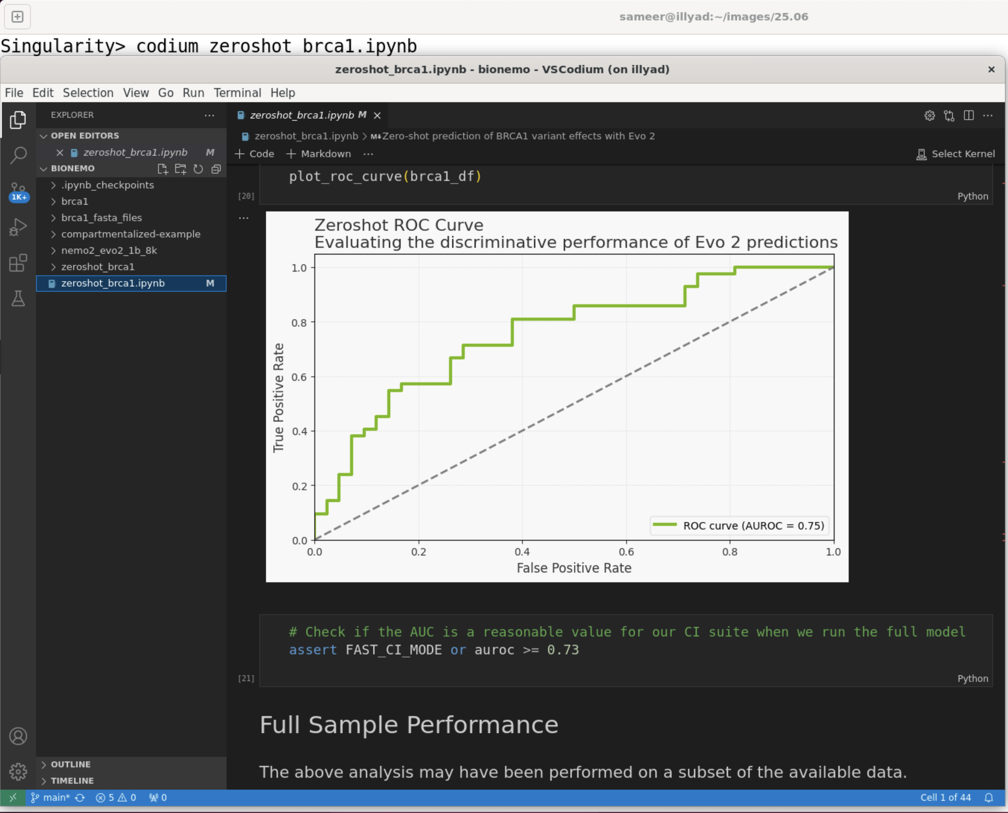
E4S 25.06 image for CUDA and x86_64 with VSCodium IDE
NVIDIA H100 (cuda90) GPU on x86_64
Jupyter Notebook in VSCodium IDE
Running NVIDIA® BioNeMoTM Framework
for biopharma workflows
https://e4s.io
Notes:
quick run through - what ECP ST is working on

Slide 34
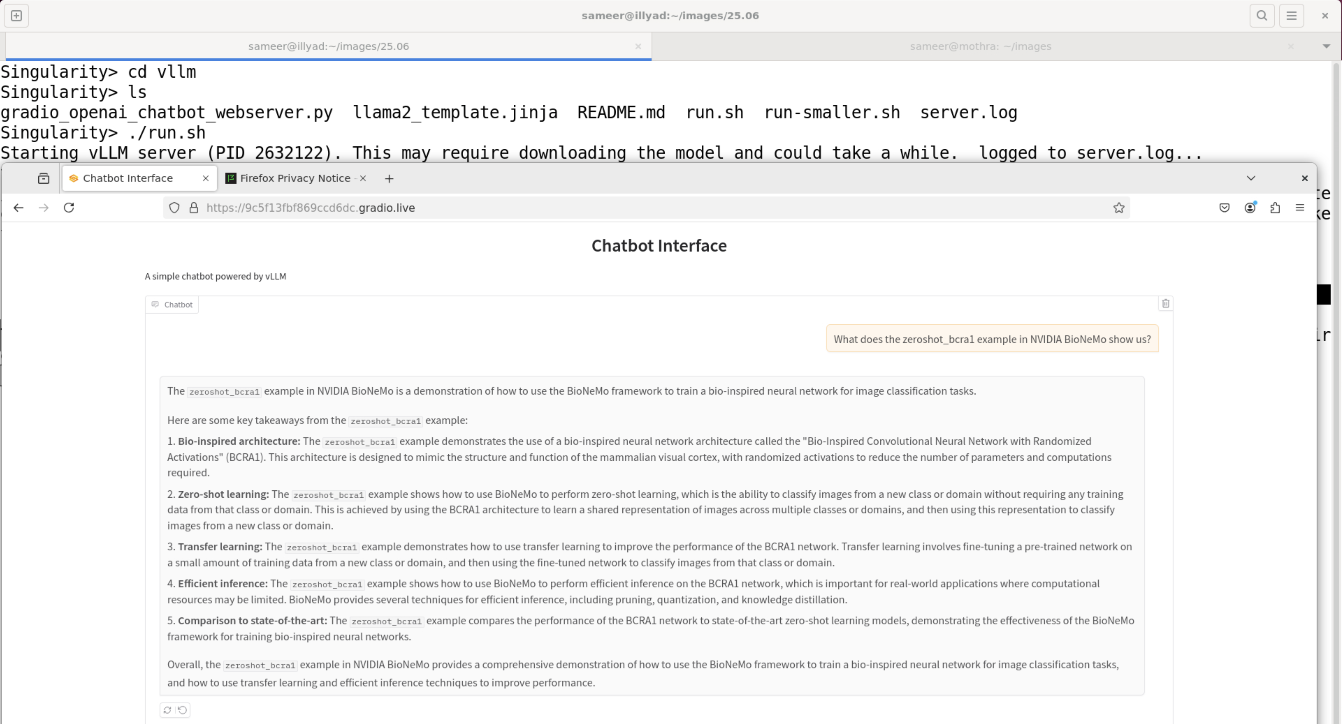
Creating a Chatbot using Vllm using E4S 25.06 image for x86_64
NVIDIA H100 (cuda90) GPU on x86_64
Vllm chatbot running after huggingface-cli login
Using local H100 GPU
https://e4s.io
Notes:
quick run through - what ECP ST is working on

Slide 35
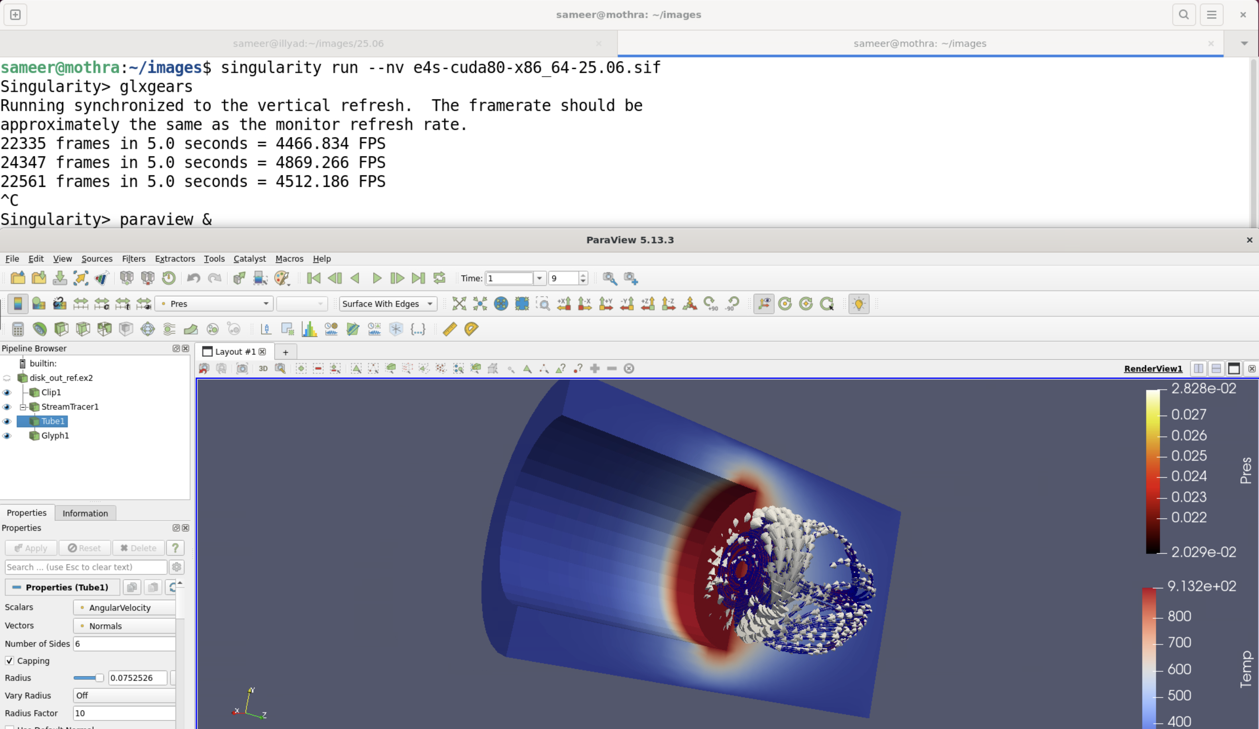
GPU accelerated 3D graphics using E4S 25.06 image for x86_64
Rendering on an NVIDIA A100 (cuda80) GPU on x86_64
ParaView
Using Adaptive Computing’s Heidi/ODDC remote desktop
https://e4s.io
Notes:
quick run through - what ECP ST is working on

Slide 36
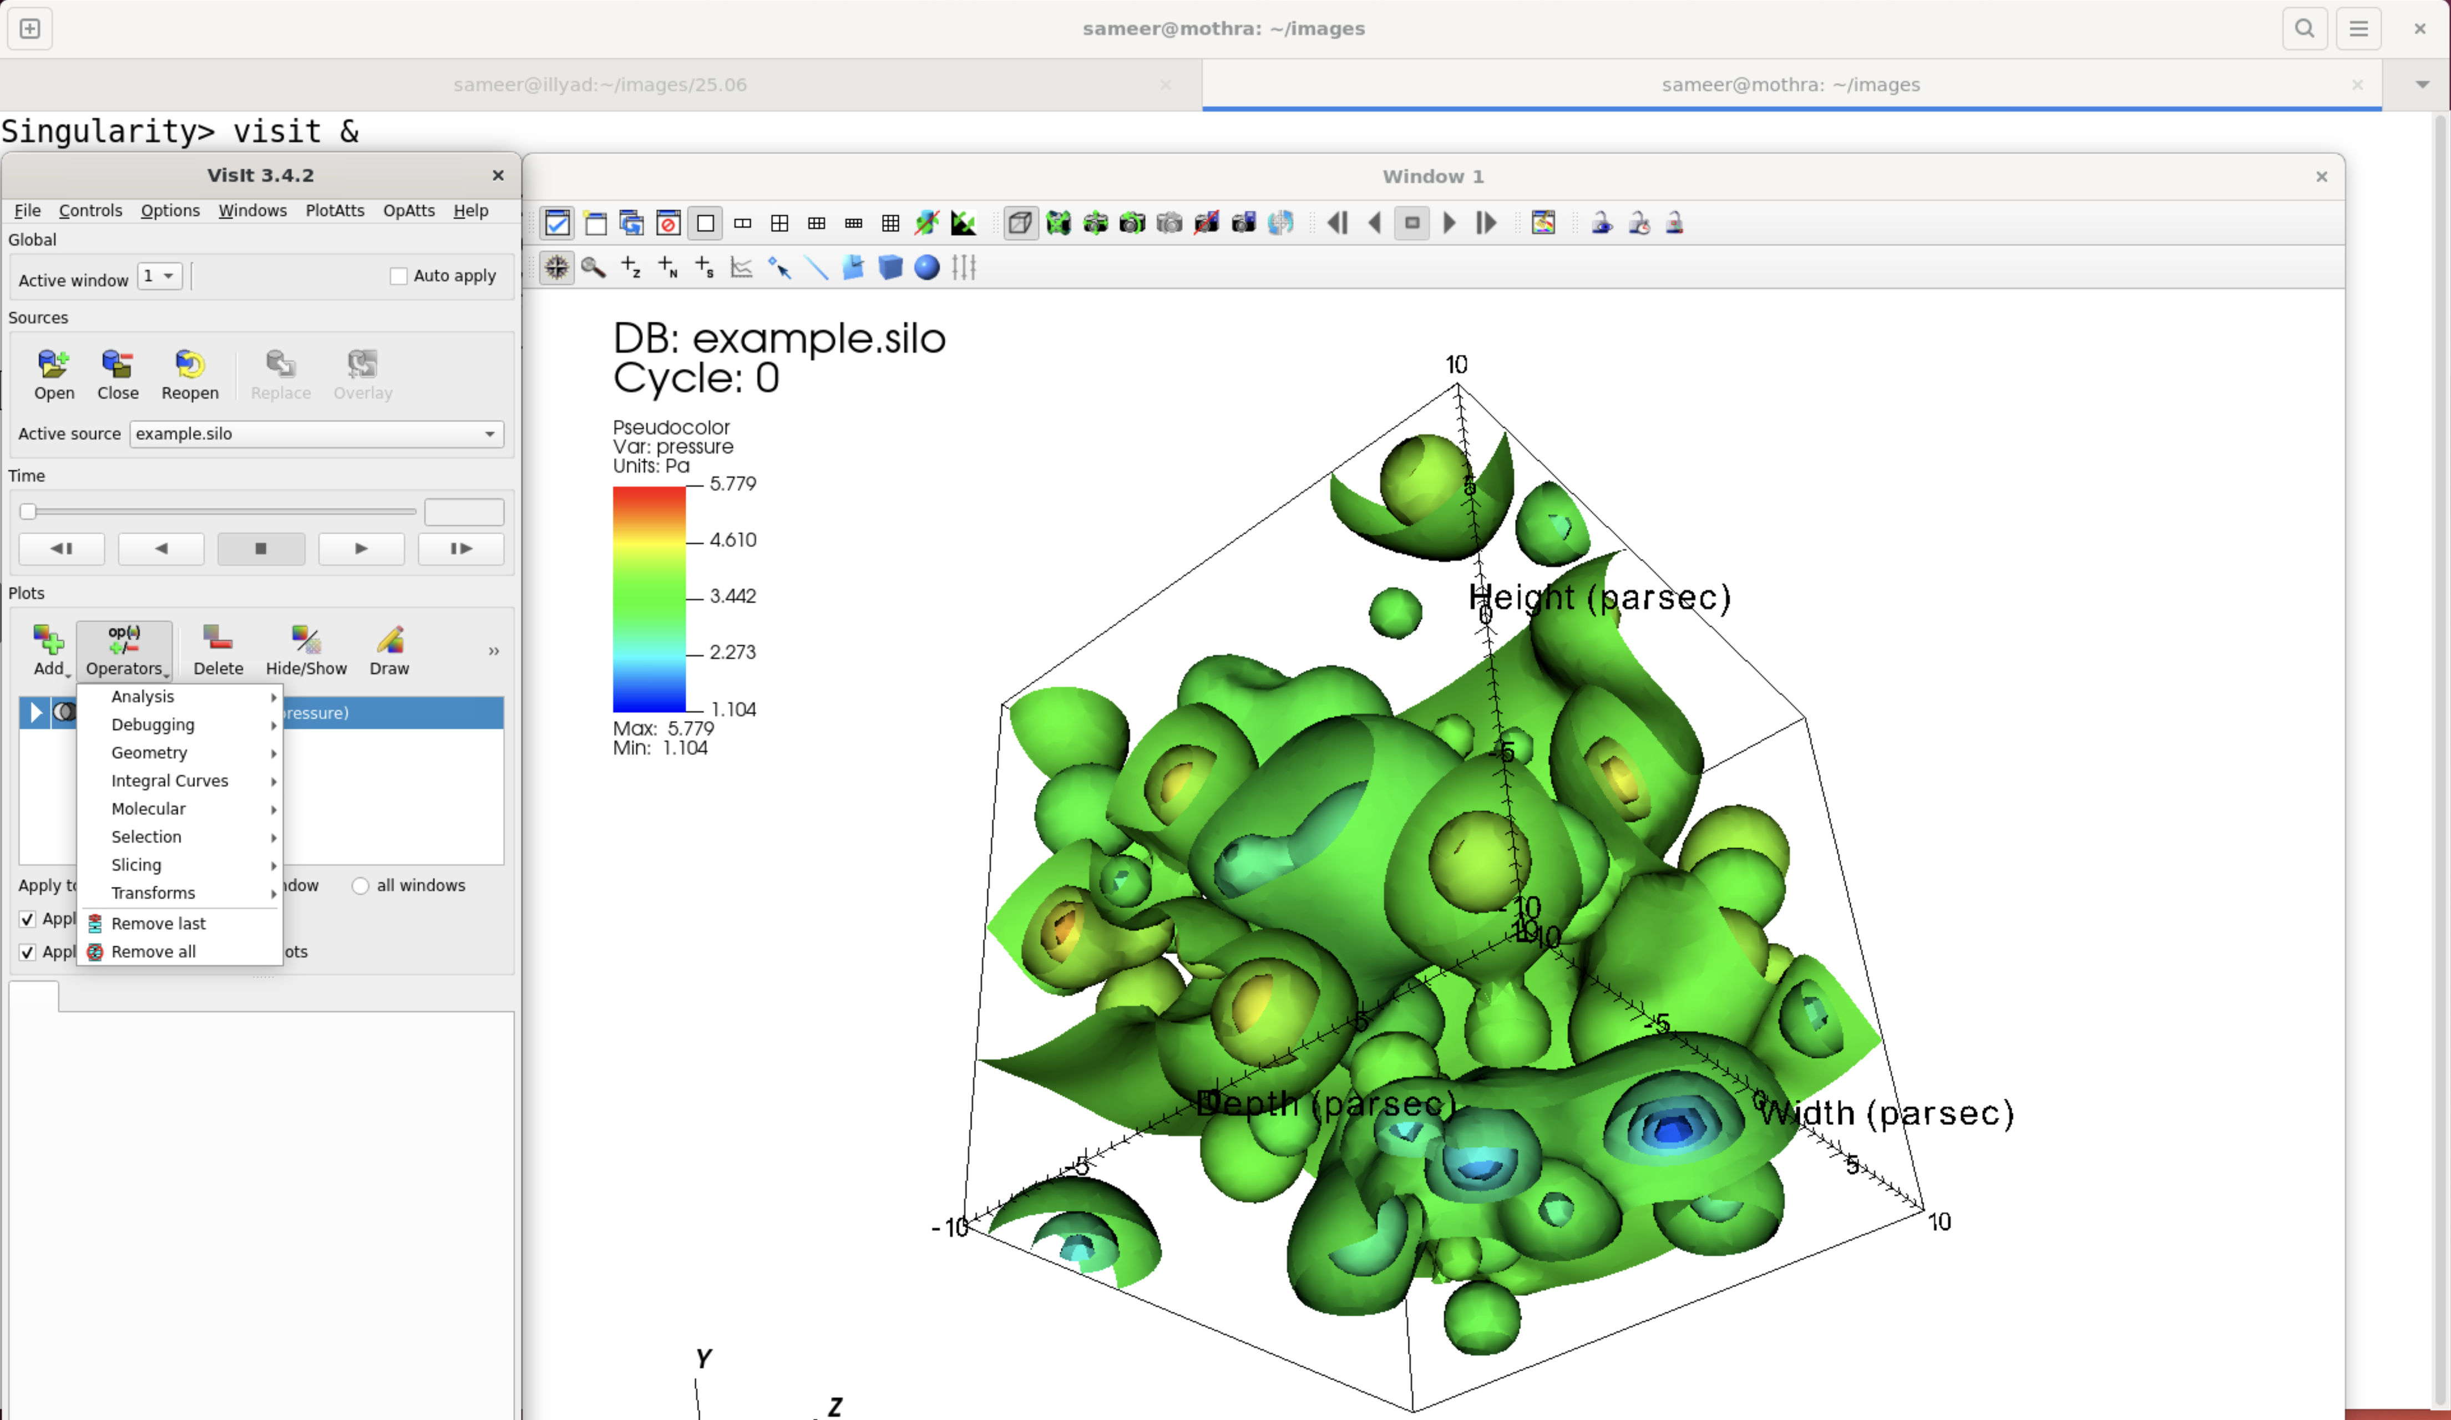
VisIt: GPU accelerated 3D graphics in E4S 25.06 image for x86_64
Rendering on an NVIDIA A100 (cuda80) GPU on x86_64
VisIt
Using Adaptive Computing’s Heidi/ODDC remote desktop
https://e4s.io
Notes:
quick run through - what ECP ST is working on

Slide 37
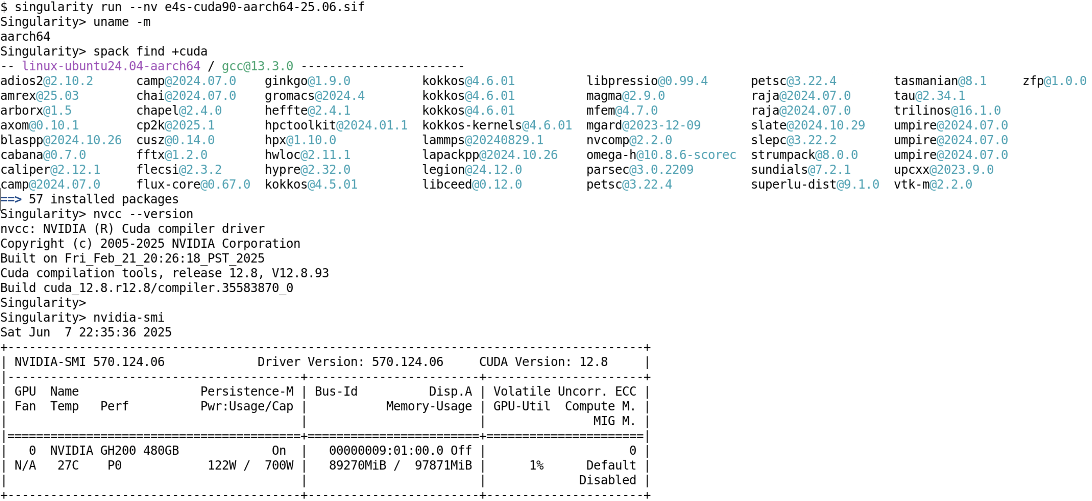
E4S 25.06 image for NVIDIA Grace-Hopper (cuda90, aarch64)
https://e4s.io
Notes:
quick run through - what ECP ST is working on

Slide 38
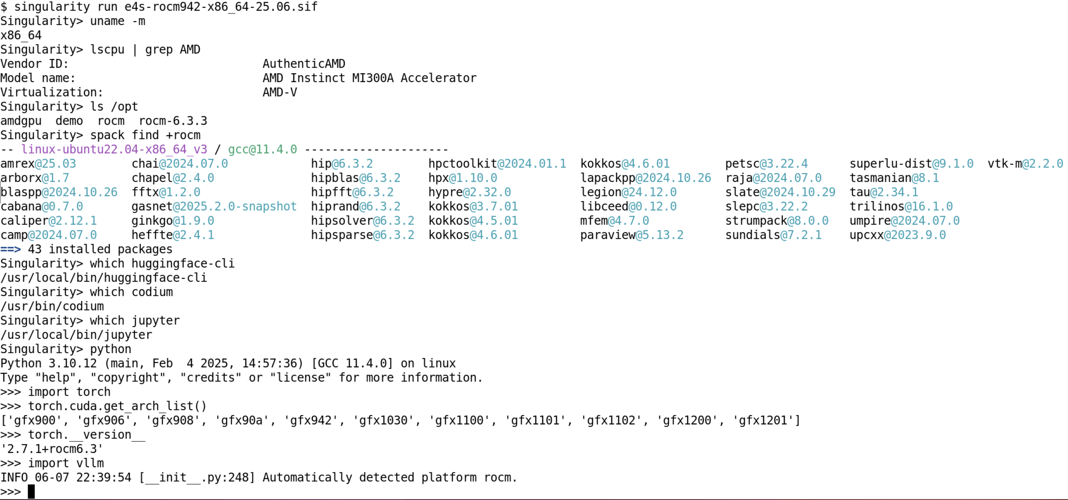
E4S 25.06 image for x86_64 for AMD MI300A GPU (ROCm 6.3.3)
https://e4s.io
Notes:
quick run through - what ECP ST is working on

Slide 39
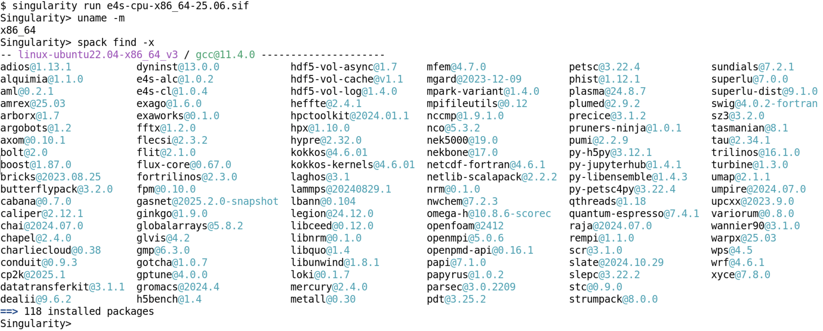
E4S 25.06 image for CPU x86_64 without GPU runtimes (GCC)
https://e4s.io
Notes:
quick run through - what ECP ST is working on

Slide 40
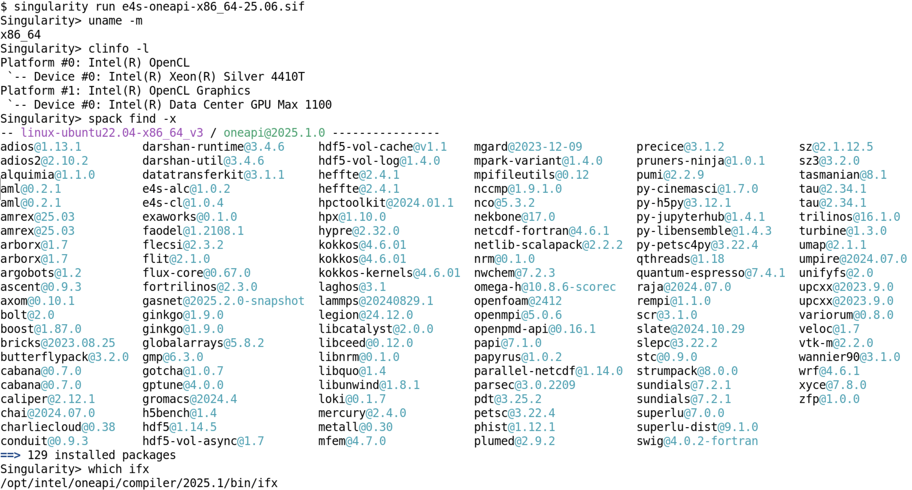
E4S 25.06 image for Intel GPUs with Intel compilers (x86_64)
https://e4s.io
Notes:
quick run through - what ECP ST is working on

Slide 41
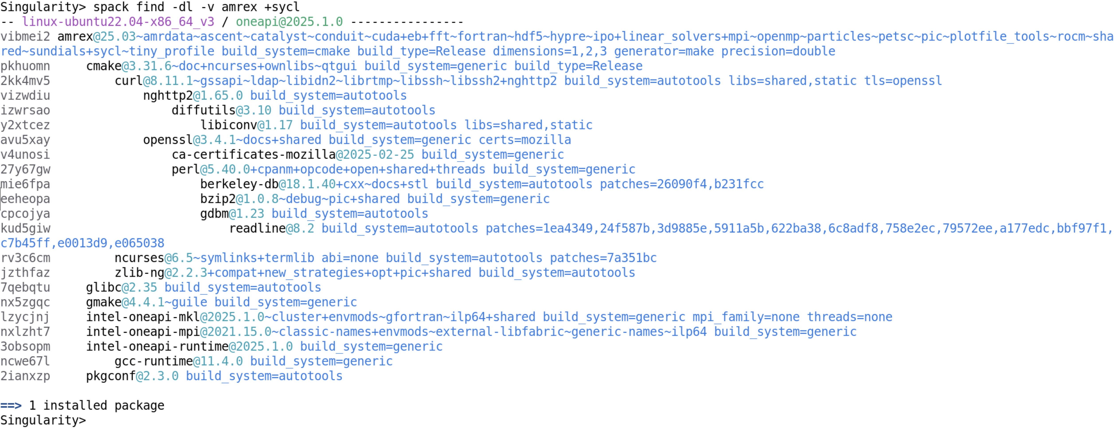
E4S 25.06 image for Intel® oneAPI built with Intel MPI and compilers
https://e4s.io
Notes:
quick run through - what ECP ST is working on

Slide 42
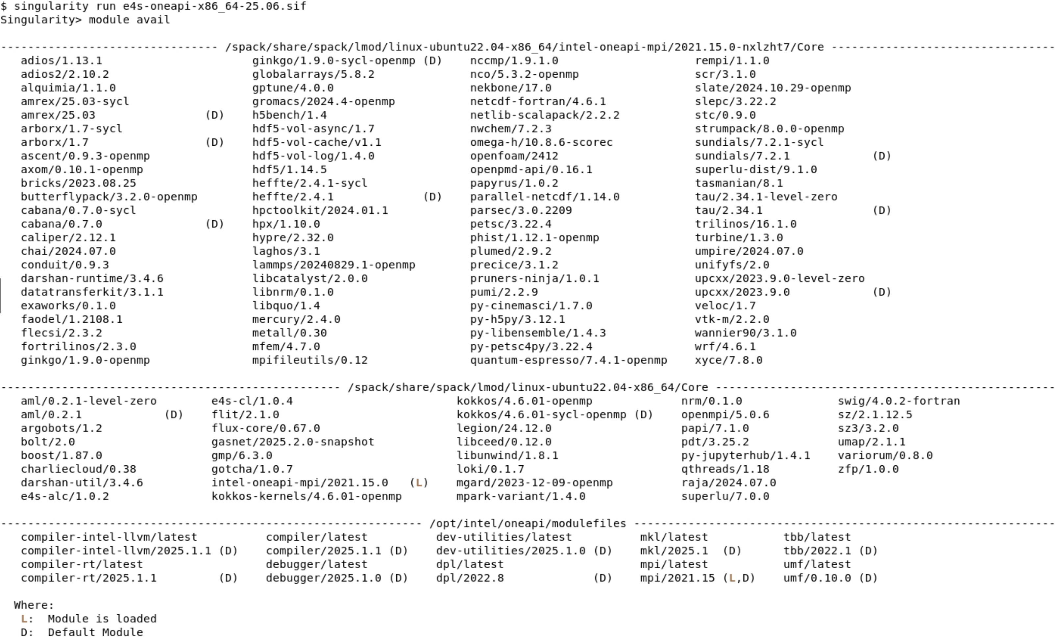
Intel oneAPI based packages in E4S 25.06 image for x86_64
https://e4s.io
Notes:
quick run through - what ECP ST is working on

Slide 43
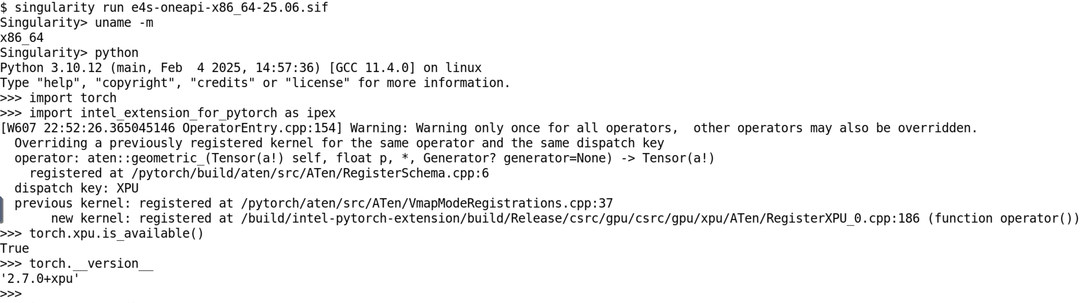
PyTorch built for Intel XPUs in E4S 25.06 Intel® oneAPI image
https://e4s.io
Notes:
quick run through - what ECP ST is working on

Slide 44
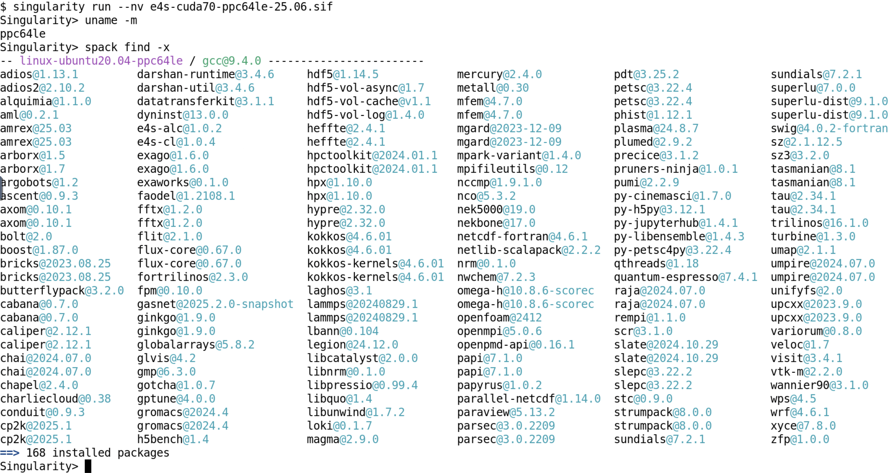
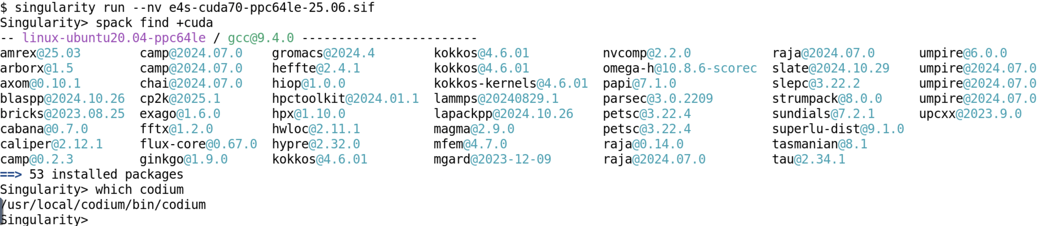
E4S 25.06 image for ppc64le with NVIDIA GPUs (IBM Power 9)
https://e4s.io
Notes:
quick run through - what ECP ST is working on

Slide 45
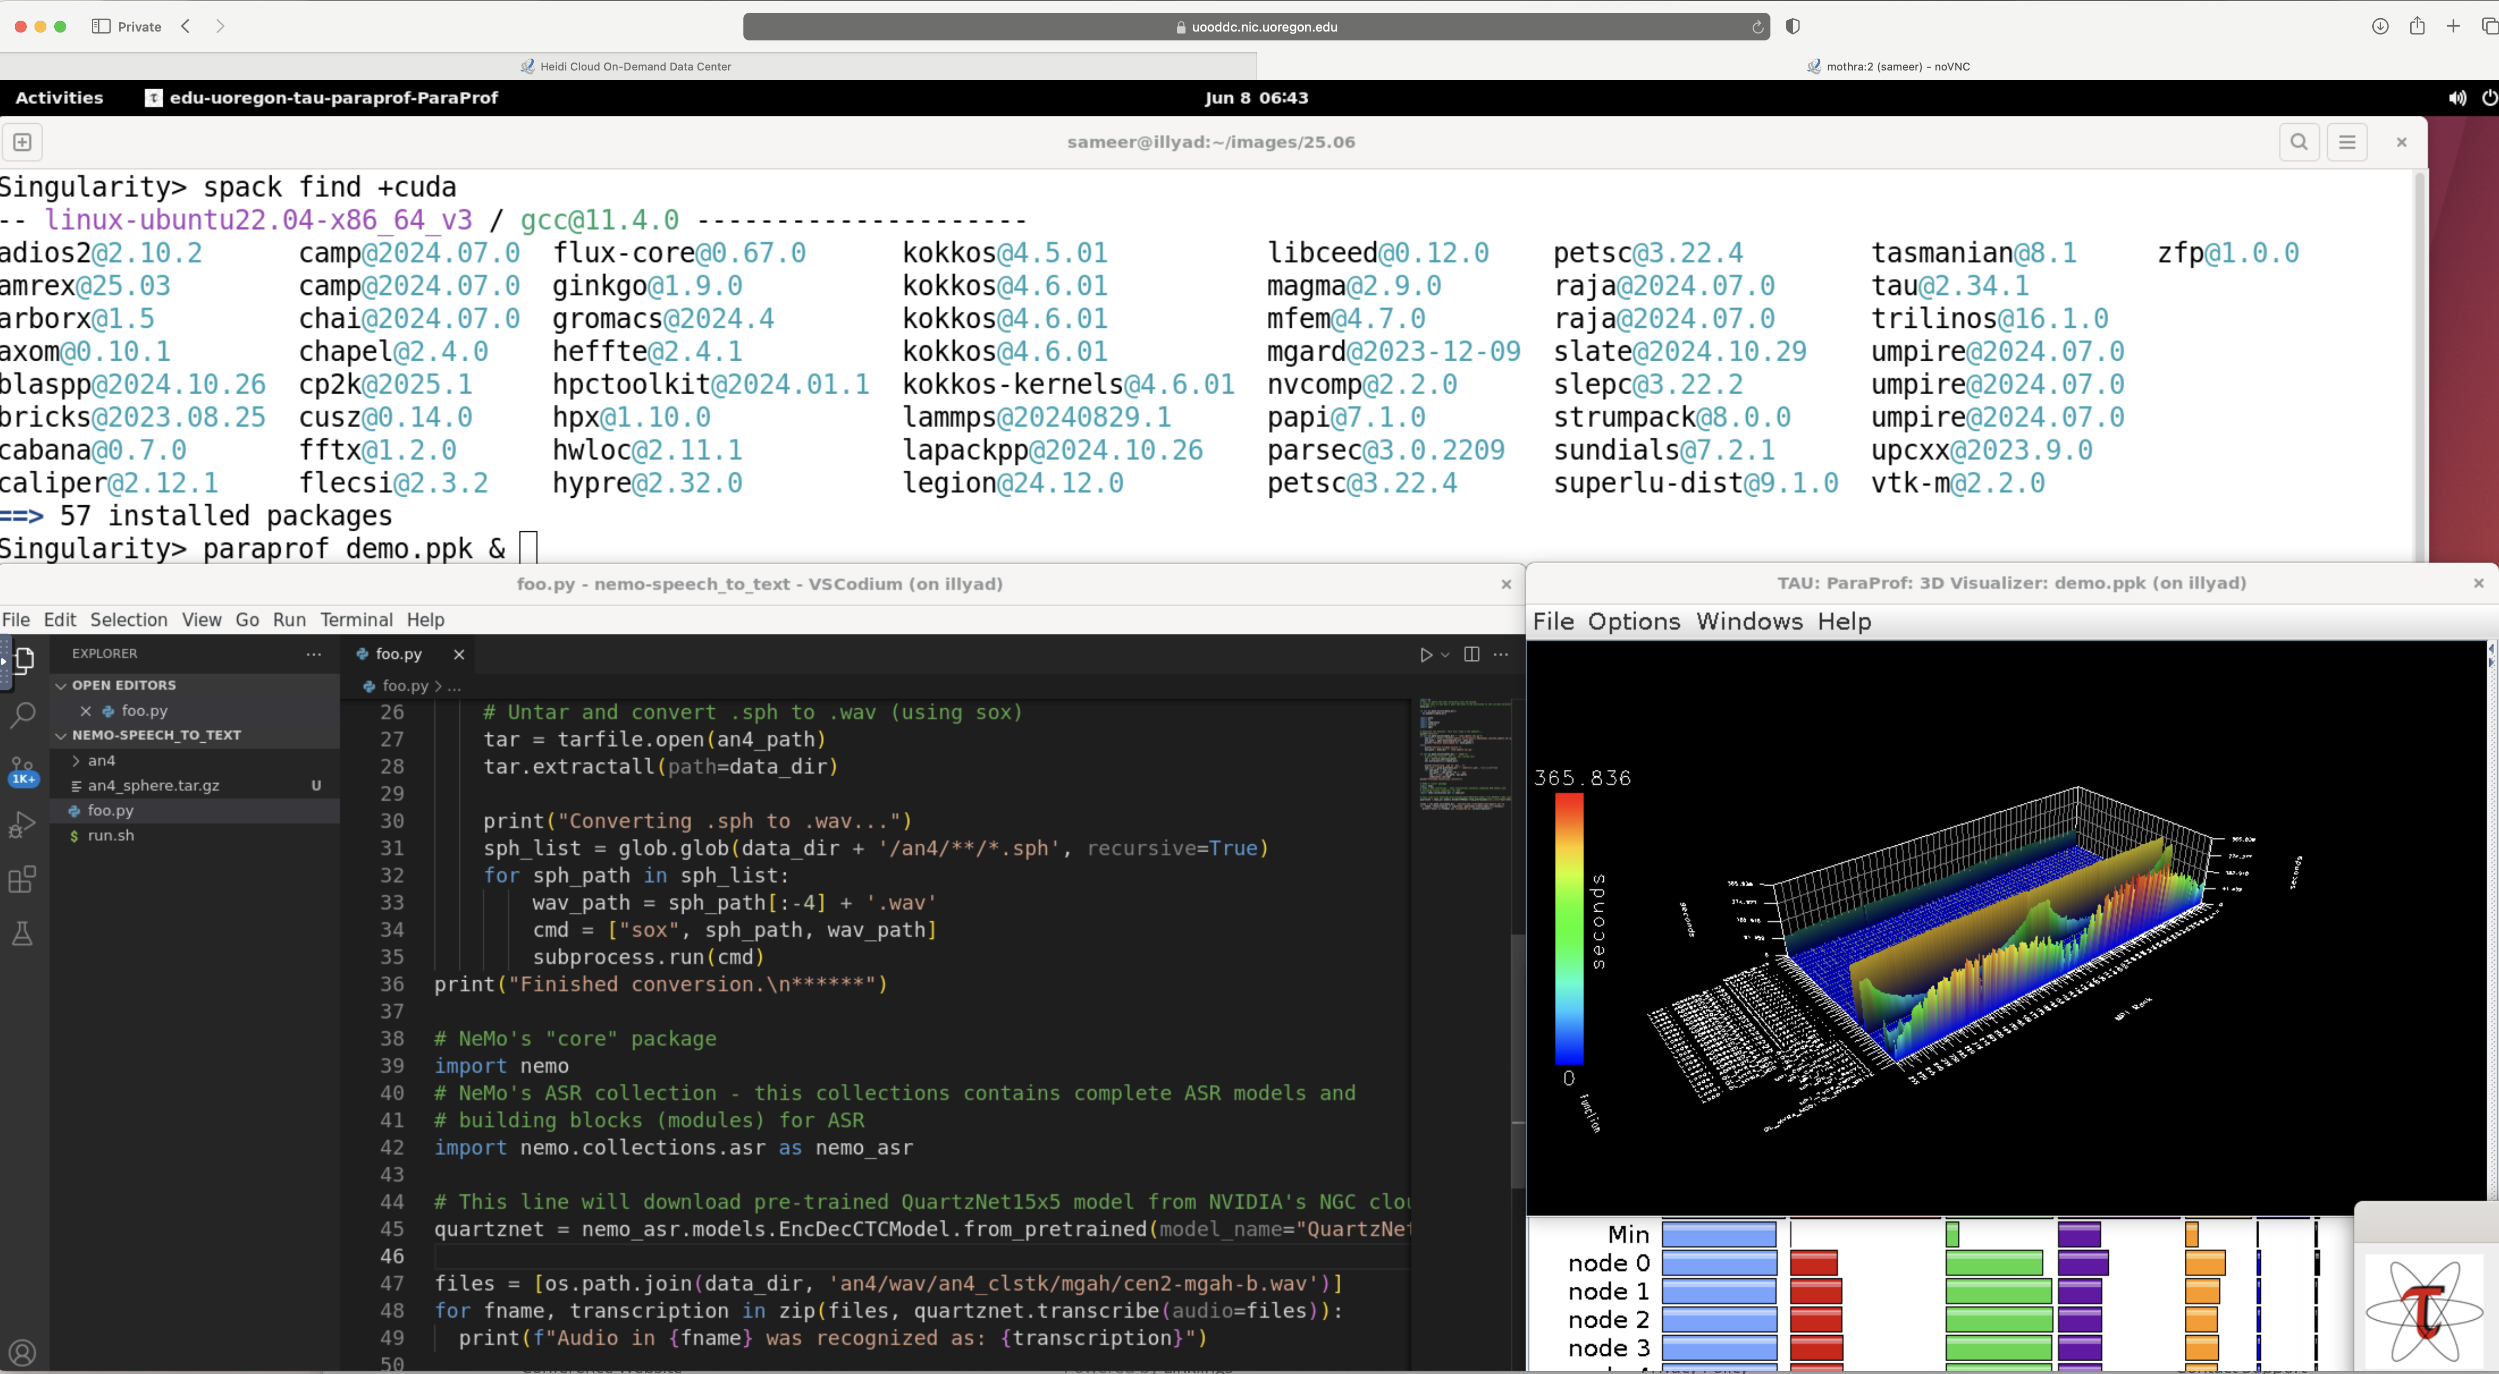
E4S: An HPC-AI Software Ecosystem for Science!
https://e4s.io

Slide 46
Acknowledgment
This material is based upon work supported by the U.S. Department of Energy, Office of Science, Office of Advanced Scientific Computing Research, Next-Generation Scientific Software Technologies program, under contract numbers DE-AC02-AC05-00OR22725 and DOE SBIR DE-SC0022502.
https://science.osti.gov/ascr
https://pesoproject.org
https://ascr-step.org
https://hpsf.io
https://www.energy.gov/technologytransitions/sbirsttr

Slide 47
Thank you
https://www.exascaleproject.org
This research was supported by the Exascale Computing Project (17-SC-20-SC), a joint project of the U.S. Department of Energy’s Office of Science and National Nuclear Security Administration, responsible for delivering a capable exascale ecosystem, including software, applications, and hardware technology, to support the nation’s exascale computing imperative.
Thank you to all collaborators in the ECP and broader computational science communities. The work discussed in this presentation represents creative contributions of many people who are passionately working toward next-generation computational science.

Slide 48


